Slide 1
Thinking through Tibetan Lamas’ Longevity:
Data and Historical Analysis

Slide 2
Chinese Monk & Tibetan Figure longevity
Julia Ulziisaikhan
December 2, 2021

Slide 3
R
R is a programming language used for statistical analysis and data visualization.

Slide 4
Lifespan Data
The dataset on Tibetan figures (n=2328) comes from Buddhist Digital Resource Center (BDRC).
The dataset on Chinese monks (n=6839) comes from Dharma Drum Authority (DDM).
Data processing steps:
Lifespan is calculated by death year minus birth year.
We remove rows that have lifespans of below 0 and above 100.
For DDM, we remove rows that have differences in birth and death range greater than 1, and the lifespan is calculated using the smallest year in the range of dates.

Slide 5
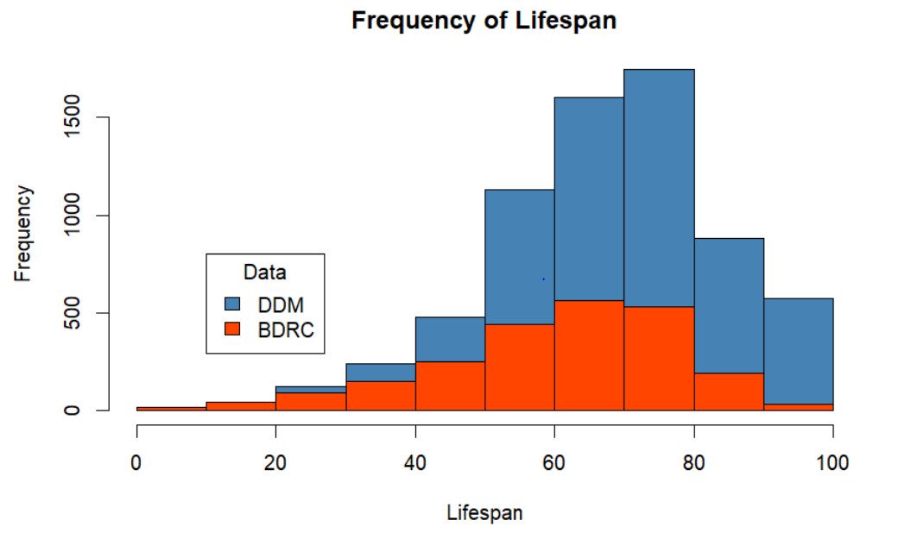
Tibetans have a large share of young lifespans (less than 50), while Chinese have a large share of older lifespans.

Slide 6
Comparing Lifespan Means of Historical
Periods

Slide 7
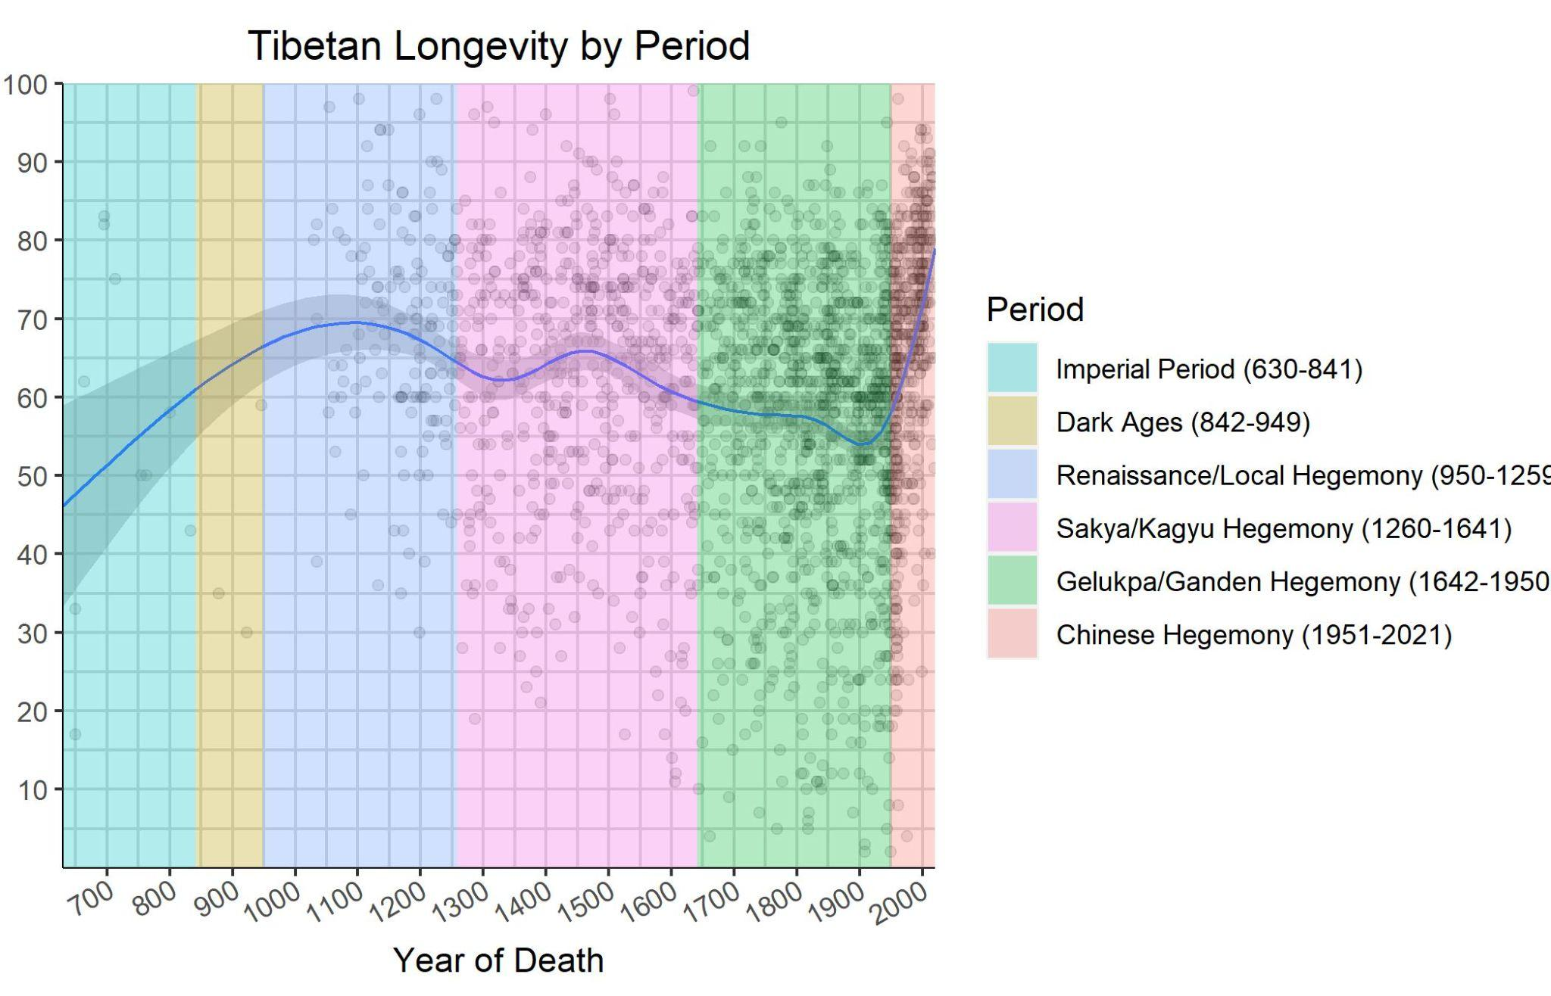

Slide 8
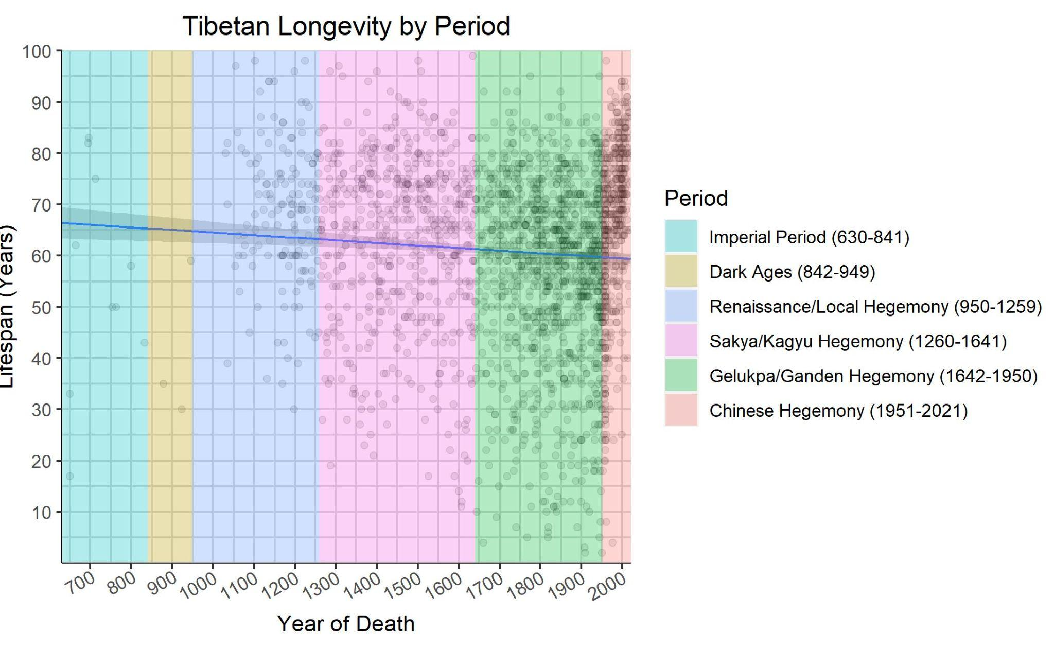

Slide 9
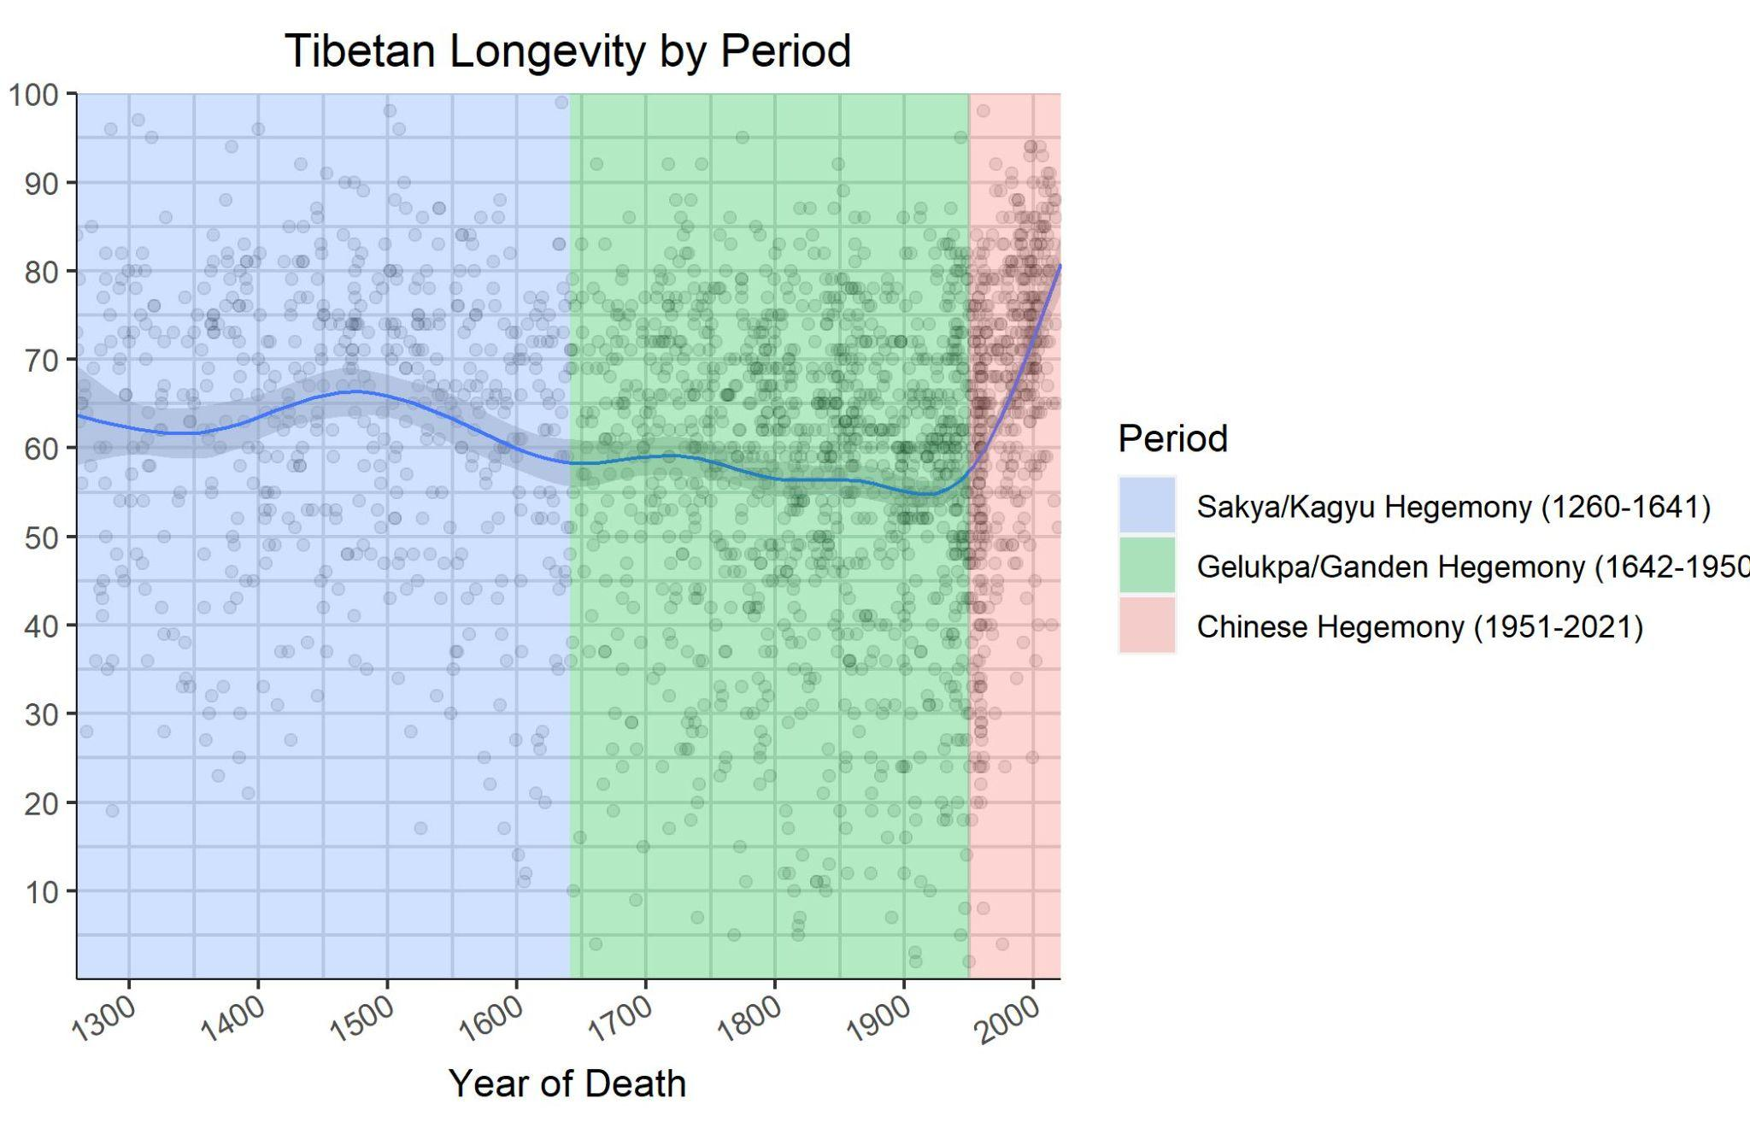

Slide 10
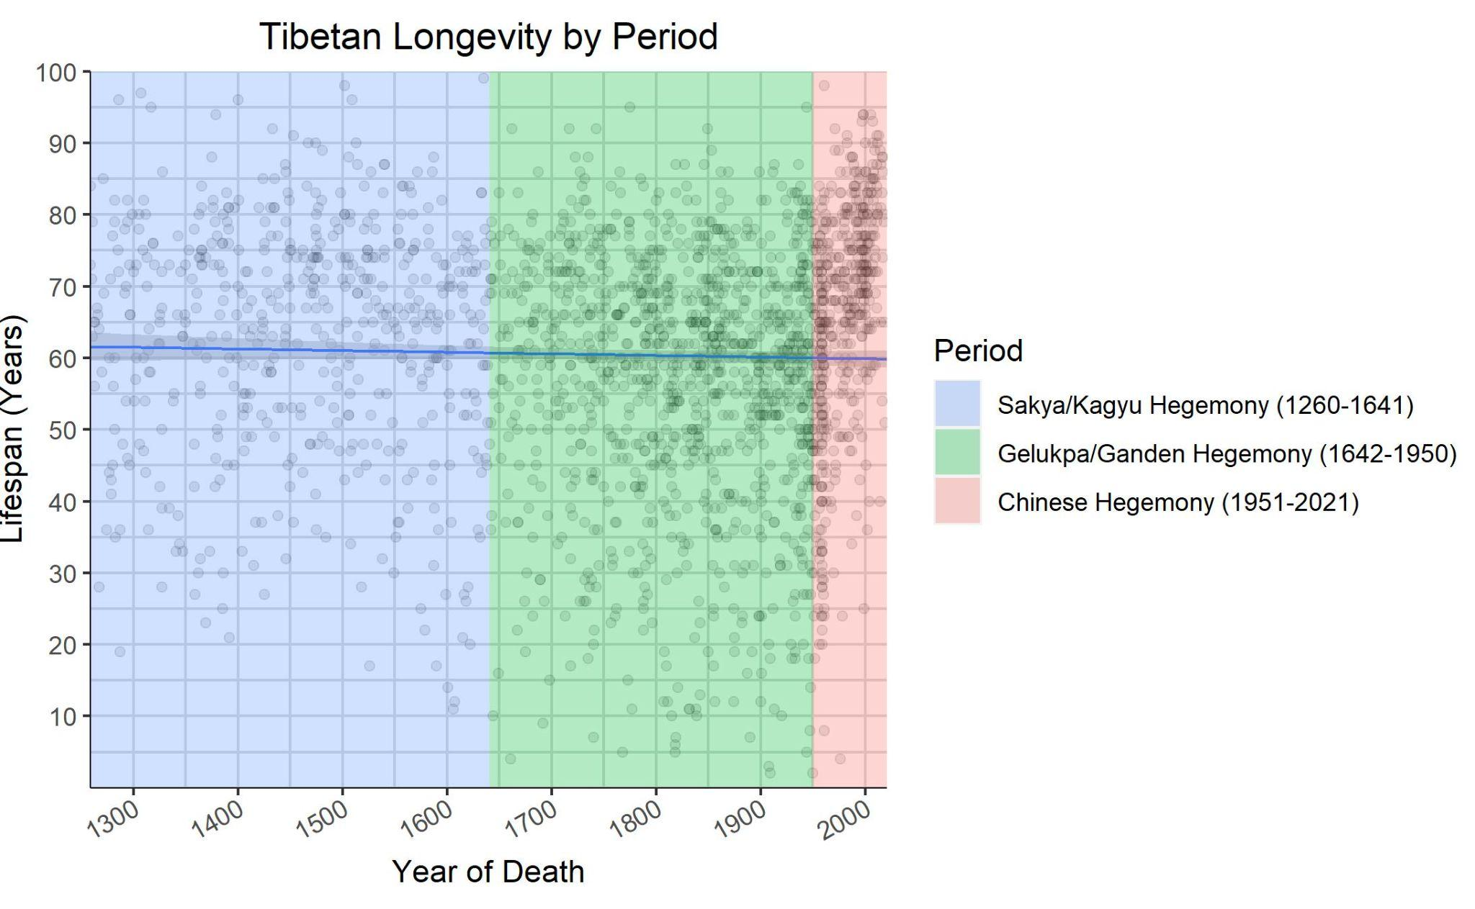

Slide 11
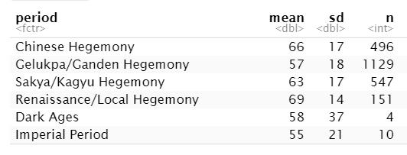
Period | n | mean lifespan
Chinese Hegemony | 494 | 65
Gelukpa/Ganden Hegemony | 1127 | 57
Sakya/Kagyu Hegemony | 542 | 63
Renaissance/Local Hegemony | 151 | 69
Dark Ages | 3 | 41
Imperial Period | 10 | 55

Slide 12
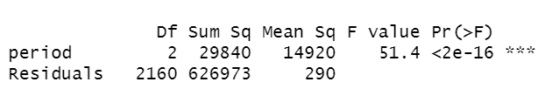
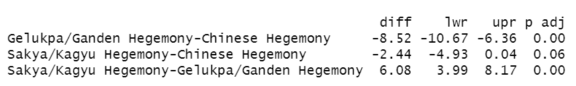
Testing Differences - Tibet
2. If ANOVA test results are significant, then we run a Tukey (Tukey’s Honest Significant Difference test) test to find out which specific period’s means (compared with each other) are different. The test compares all possible pairs of means.
We first conduct an ANOVA (Analysis of Variance) test, which has detected a significant effect of historical period on lifespan. We know this because the p-value<0.05.
Notes:
Reading: https://bookdown.org/steve_midway/DAR/understanding-anova-in-r.html
https://www.statisticshowto.com/tukey-test-honest-significant-difference/

Slide 13
Testing Differences - Tibet
Comparison | Difference | Lower Est. | Upper Est. | p-value
Gelukpa/Ganden - Chinese Hegemony | -8.52 | -10.67 | -6.36 | 0*
Sakya/Kagyu - Chinese Hegemony | -2.44 | -4.93 | 0.04 | 0.06
Sakya/Kagyu - Gelukpa/Ganden Hegemony | 6.08 | 3.99 | 8.17 | 0*
Out of 3 comparisons, only two pairs have significant differences in means at the 95% confidence level. There is no significant difference between the Sakya/Kagyu and Chinese Hegemonies, but it is close (p=0.06).
Refer to the previous summary table and scatterplot for visual aid.

Slide 14
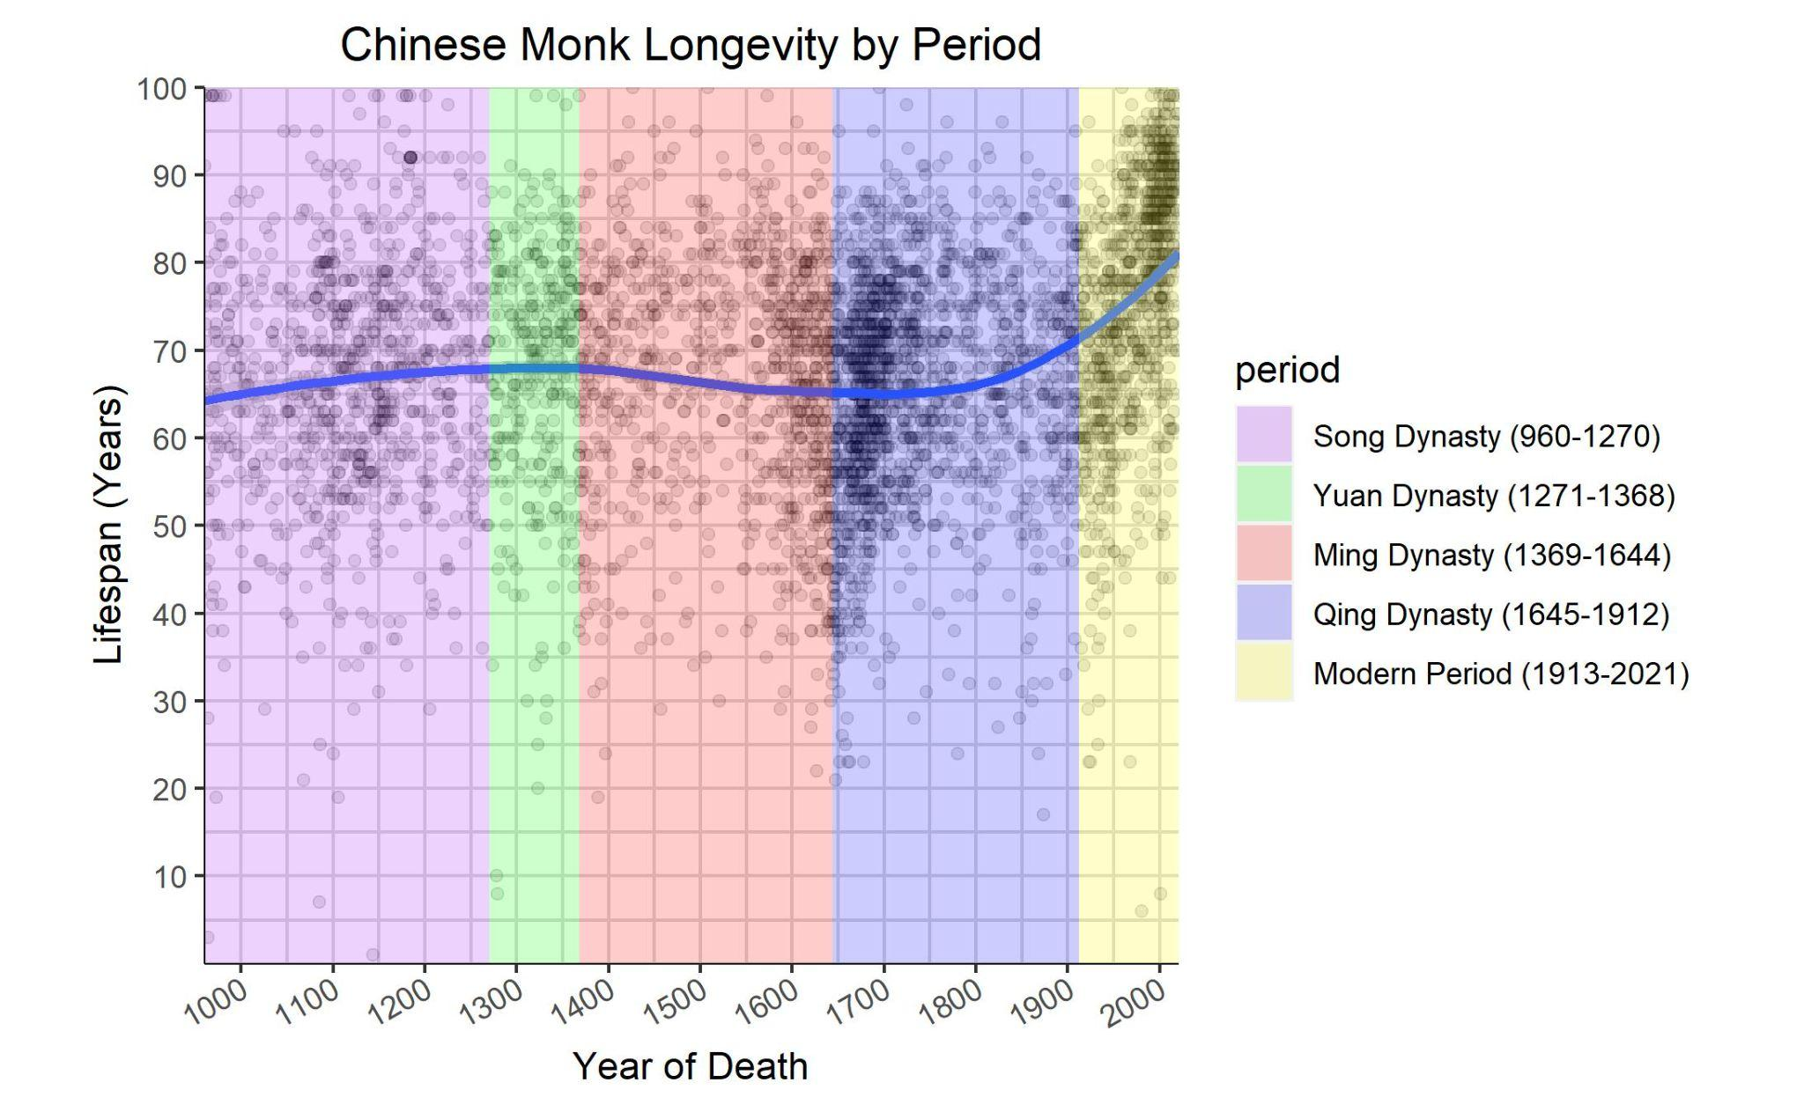

Slide 15


Slide 16
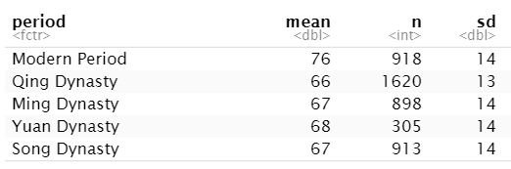
Period | n | mean lifespan | st. dev. lifespan
Modern Period | 918 | 76 | 14
Qing Dynasty | 1620 | 66 | 13
Ming Dynasty | 898 | 67 | 14
Yuan Dynasty | 305 | 68 | 14
Song Dynasty | 913 | 67 | 14

Slide 17
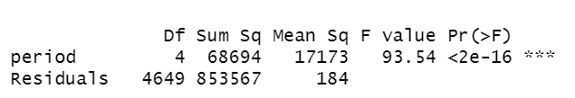
Testing Differences - China
Our ANOVA (Analysis of Variance) test has detected a significant effect of historical period on lifespan for the Chinese data.

Slide 18
Comparison | Difference | Lower Est. | Upper Est. | p-value
Modern Period - Ming Dynasty | 9.13 | 7.4 | 10.87 | 0*
Qing Dynasty - Ming Dynasty | -1.09 | -2.63 | 0.45 | 0.3
Song Dynasty - Ming Dynasty | -0.07 | -1.81 | 1.67 | 1
Yuan Dynasty - Ming Dynasty | 0.99 | -1.46 | 3.44 | 0.81
Qing Dynasty - Modern Period | -10.22 | -11.75 | -8.69 | 0*
Song Dynasty - Modern Period | -9.21 | -10.93 | -7.48 | 0*
Yuan Dynasty - Modern Period | -8.15 | -10.59 | -5.7 | 0*
Song Dynasty - Qing Dynasty | 1.02 | -0.51 | 2.55 | 0.37
Yuan Dynasty - Qing Dynasty | 2.08 | -0.23 | 4.38 | 0.1
Yuan Dynasty - Song Dynasty | 1.06 | -1.39 | 3.51 | 0.76

Slide 19
Heat Maps

Slide 20
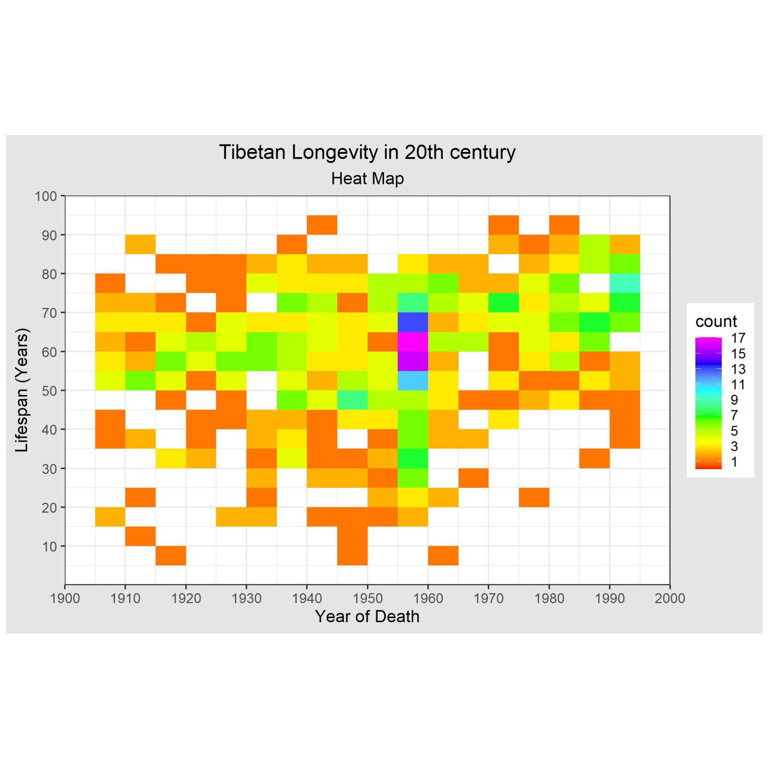

Slide 21
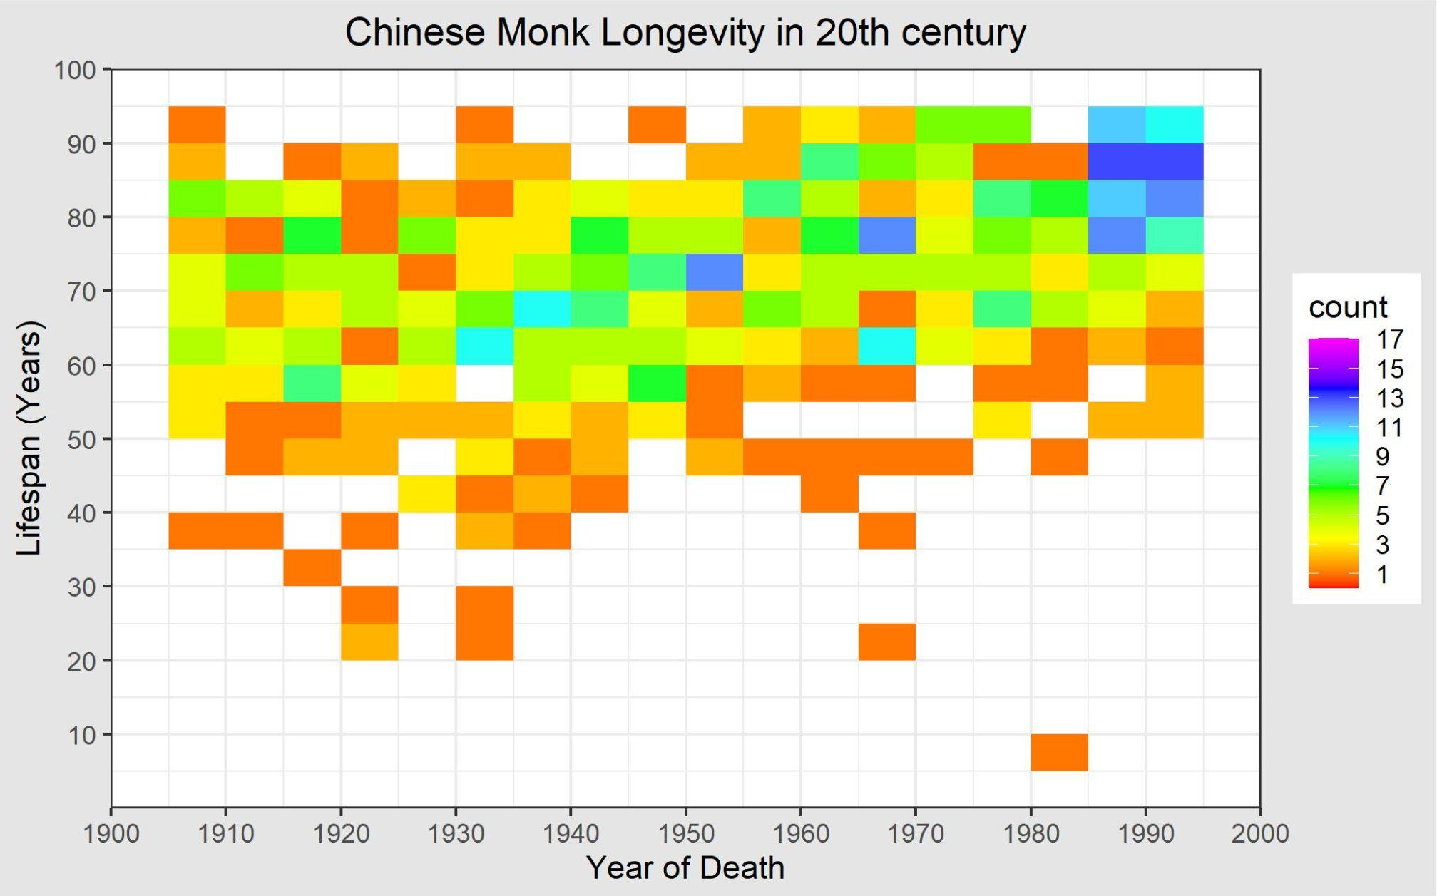

Slide 22
Orange boxes are single observations.
Note that many deaths of Tibetan 50-70 year olds were recorded between 1955 and 1950 (pink squares)

Slide 23
Growth of Tibetan Young Deaths Recorded

Slide 24
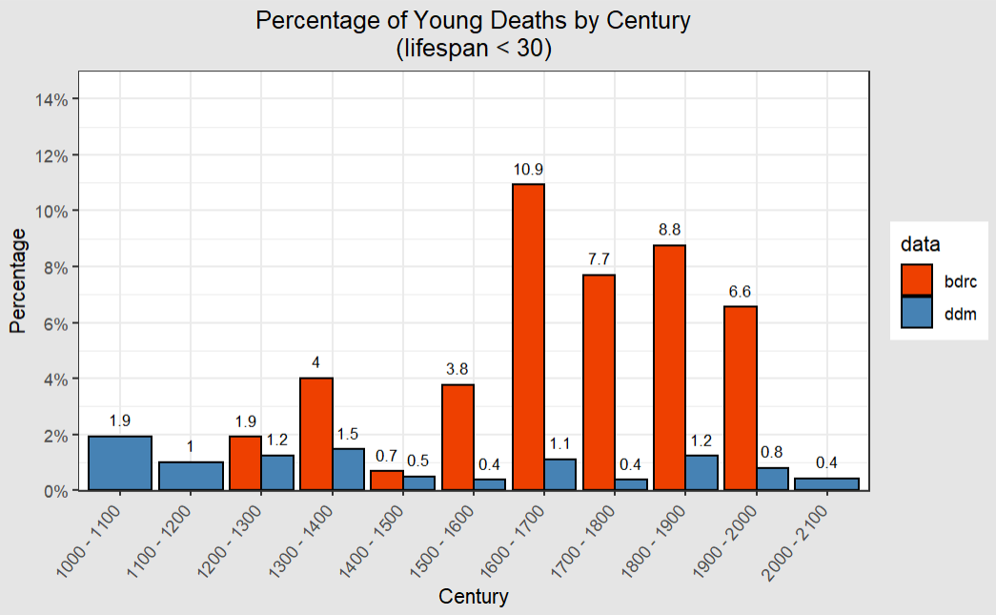

Slide 25
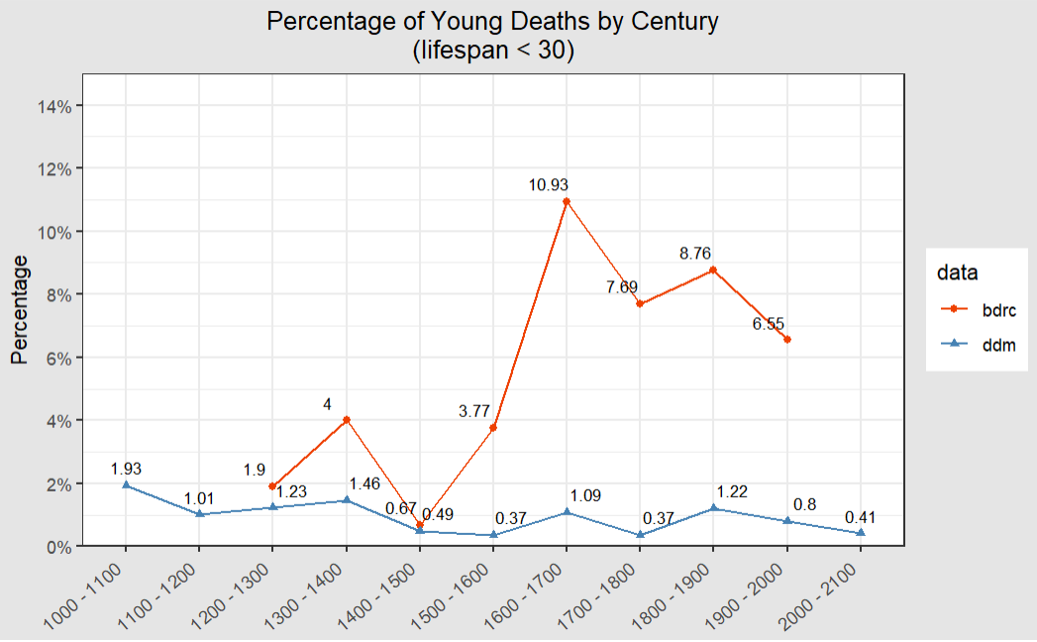

Slide 26
Growth of Incarnation Lineages

Slide 27
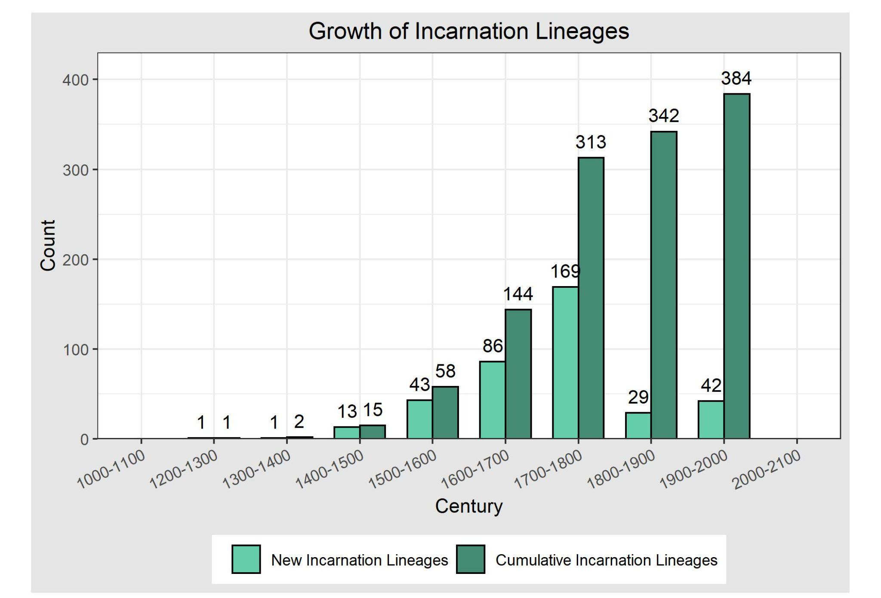

Slide 28
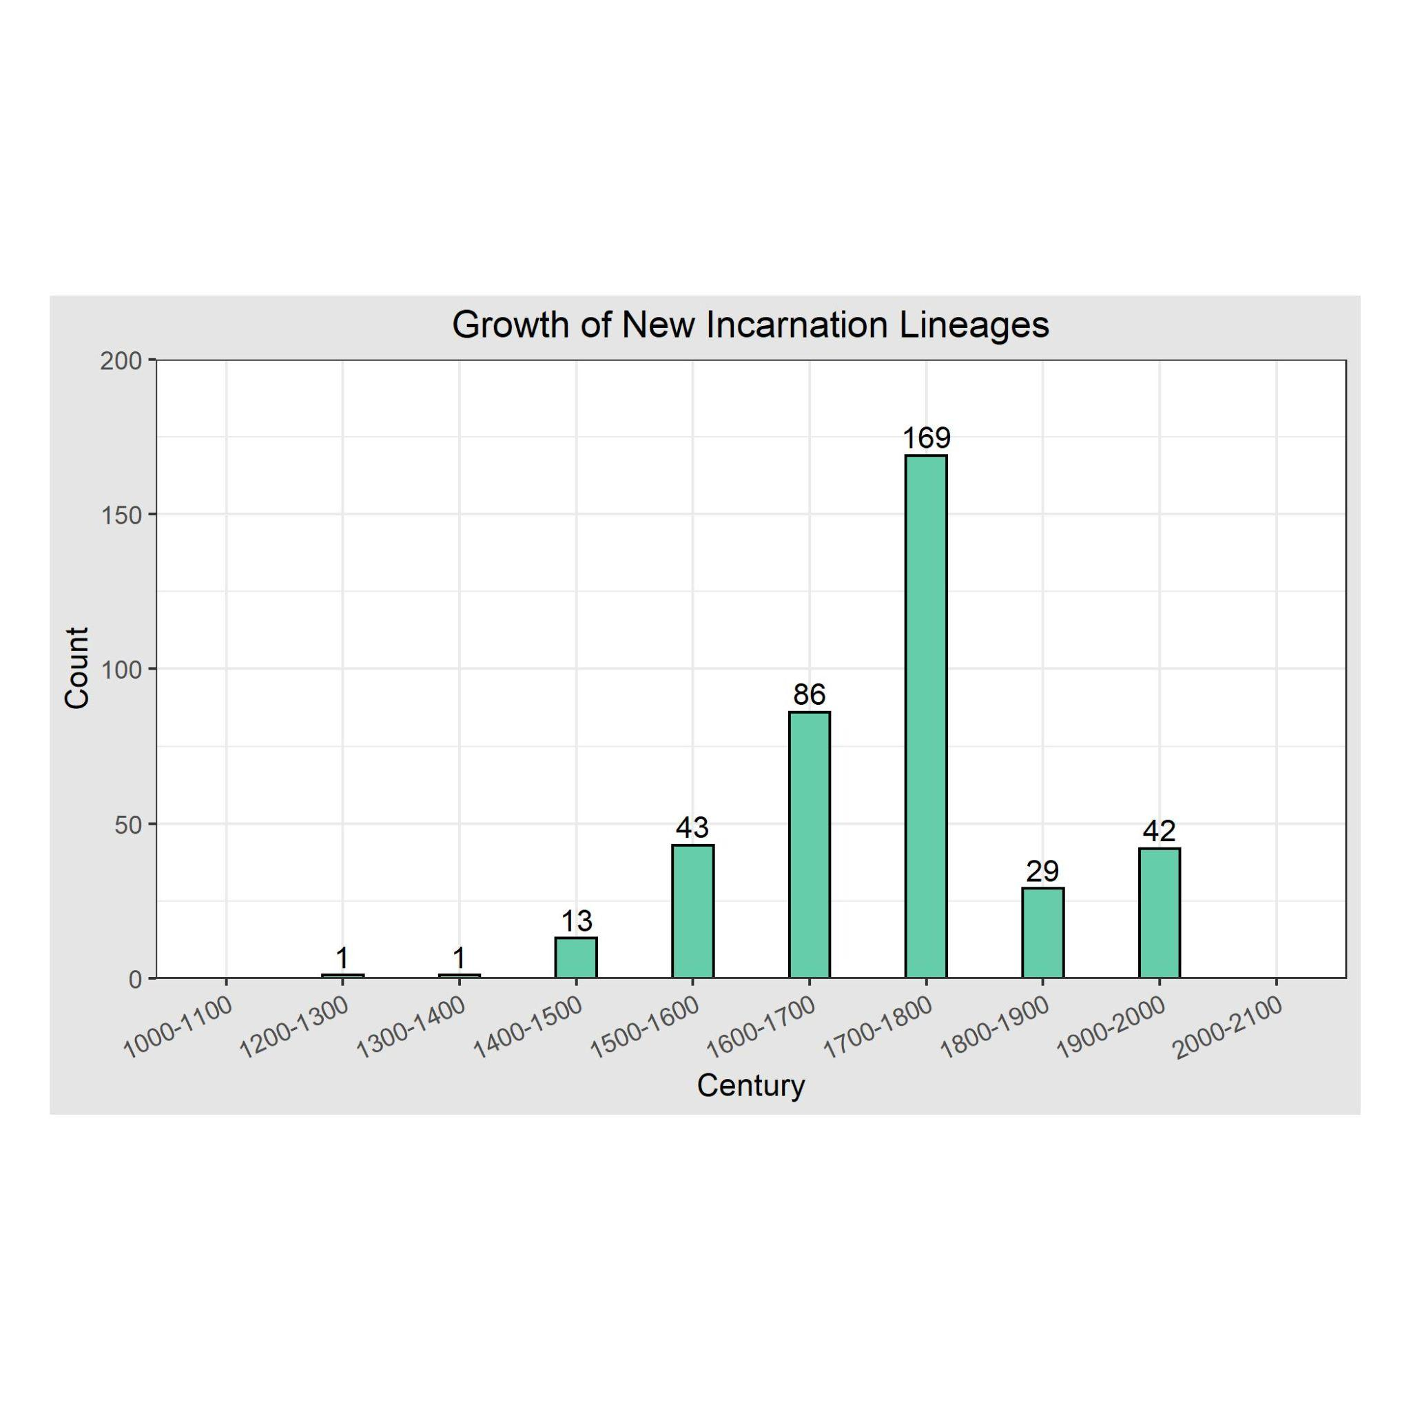

Slide 29
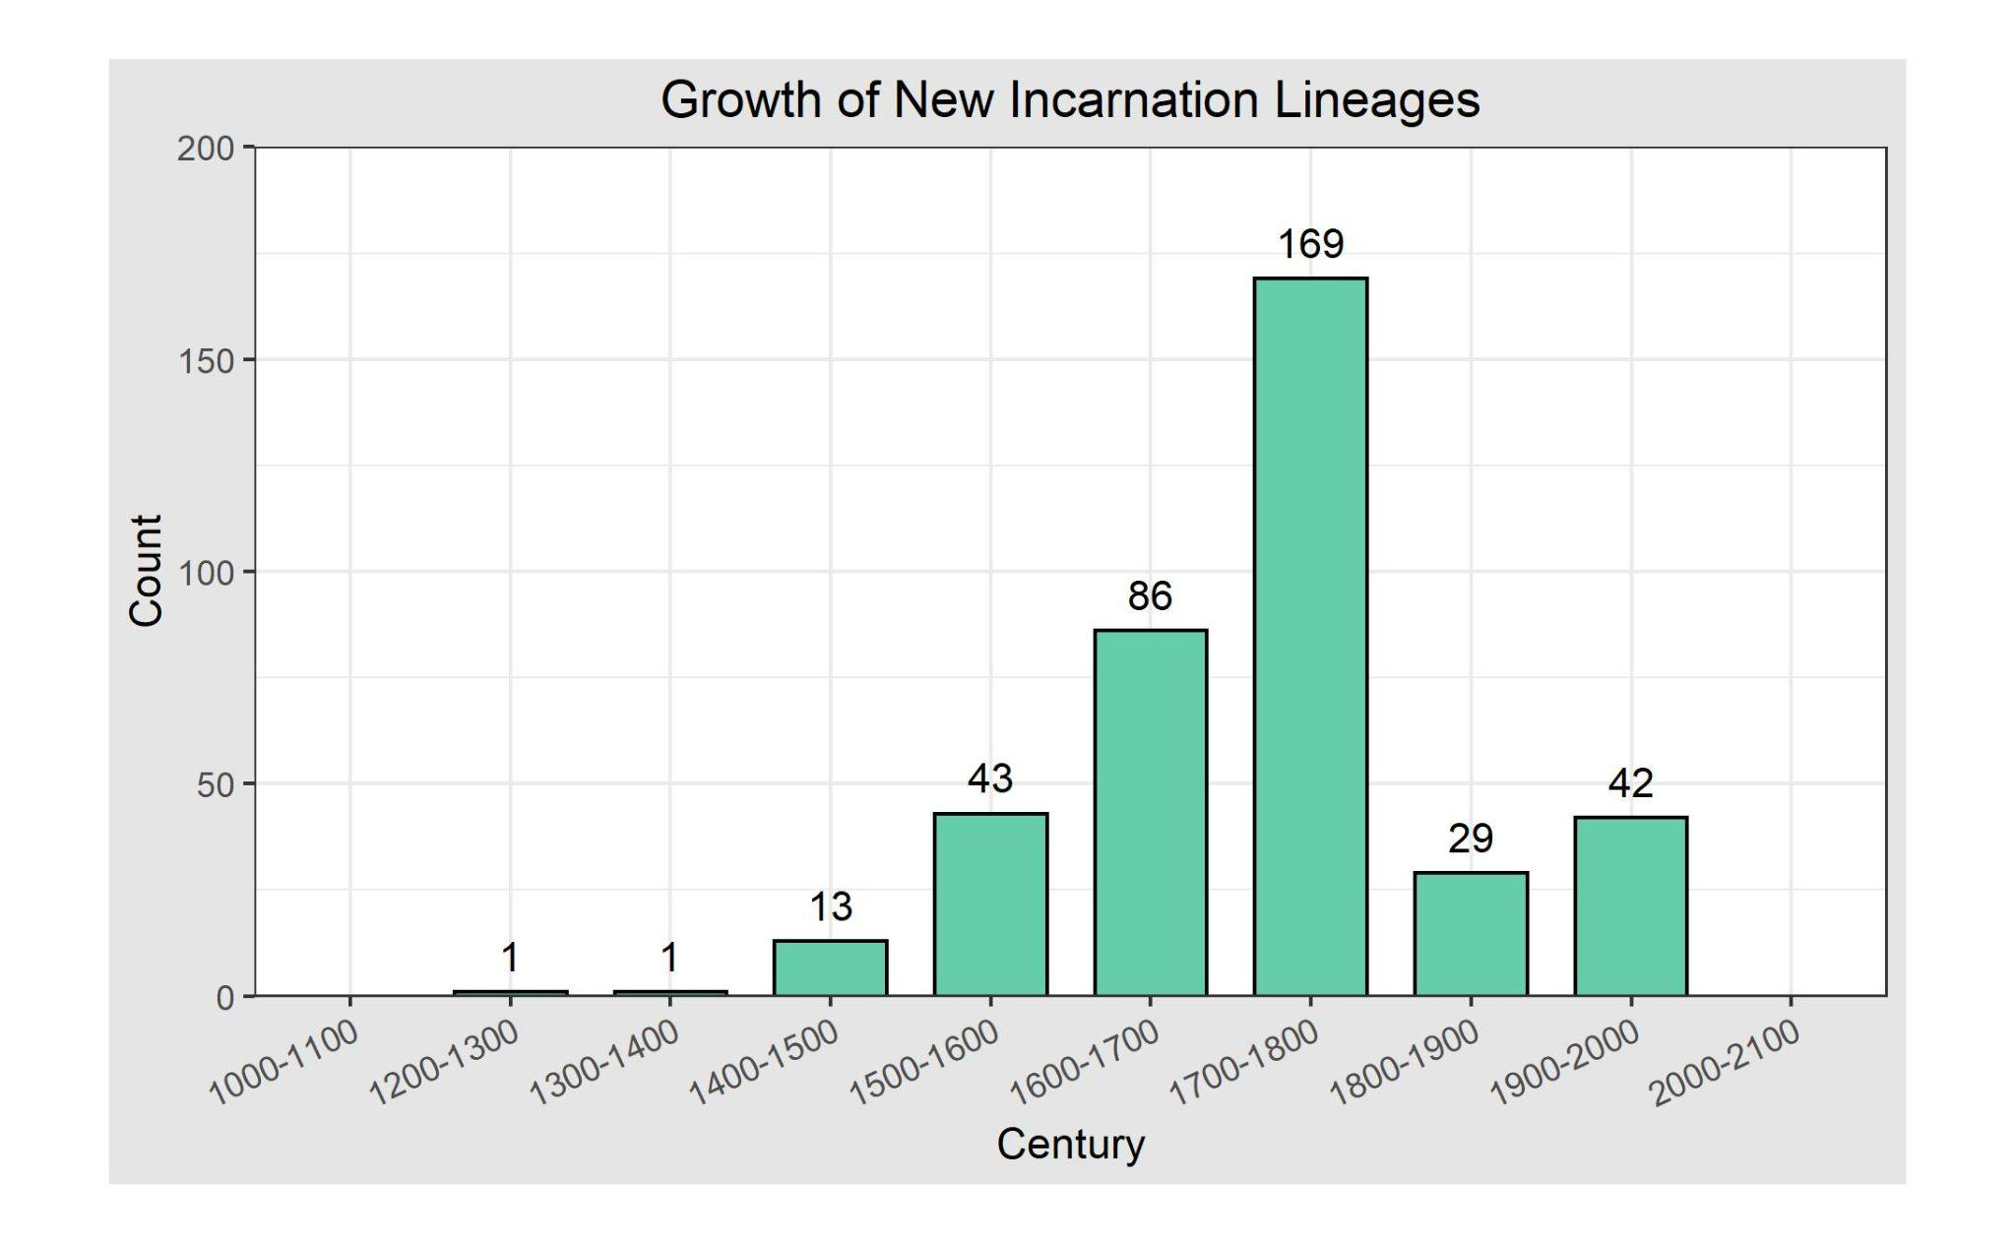
Delete me:
This one has wider bars, no difference from the last slide.

Slide 30
Delete me:
This is a side by side. I’ve tried to align it to the best of my ability but it is not perfect

Slide 31
Scatterplot with Fitted Regression Models

Slide 32
What is regression?
Regression helps one understand how the value of a dependent variable changes as the independent variable changes. In our case, we investigate how change of time influences the lifespan for Tibetans and Chinese.
A linear regression model fits the best possible straight line through a set of points. “Best” means minimizing each point’s difference from the line.
A loess regression model fits the best possible curve through a set of points. It is also thought of as a complex moving average fit.

Slide 33
All Data

Slide 34
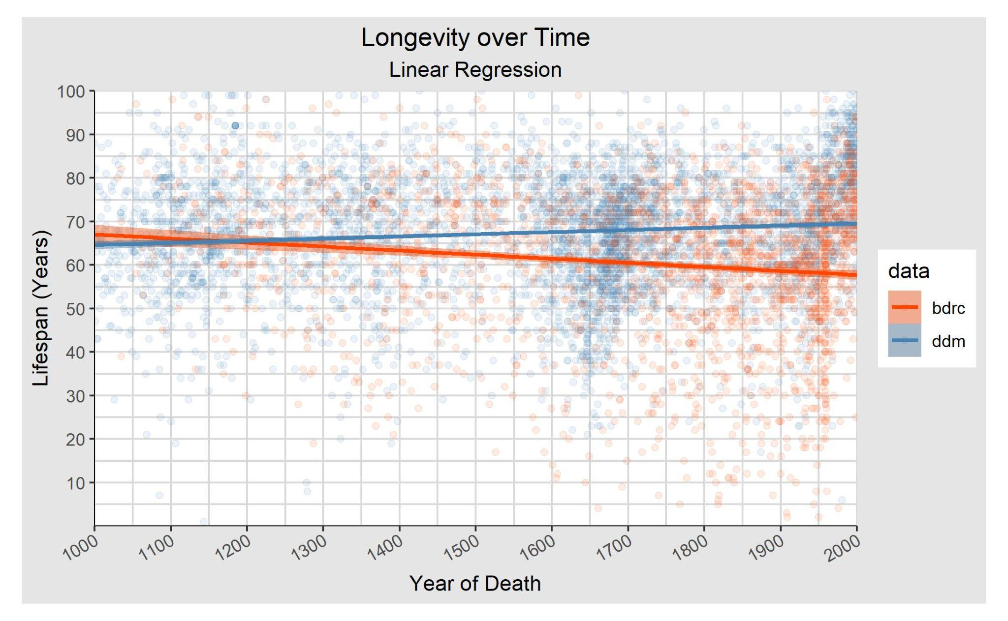

Slide 35
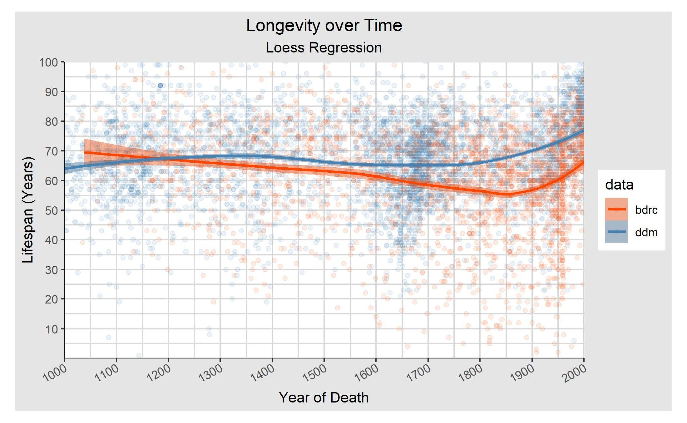

Slide 36
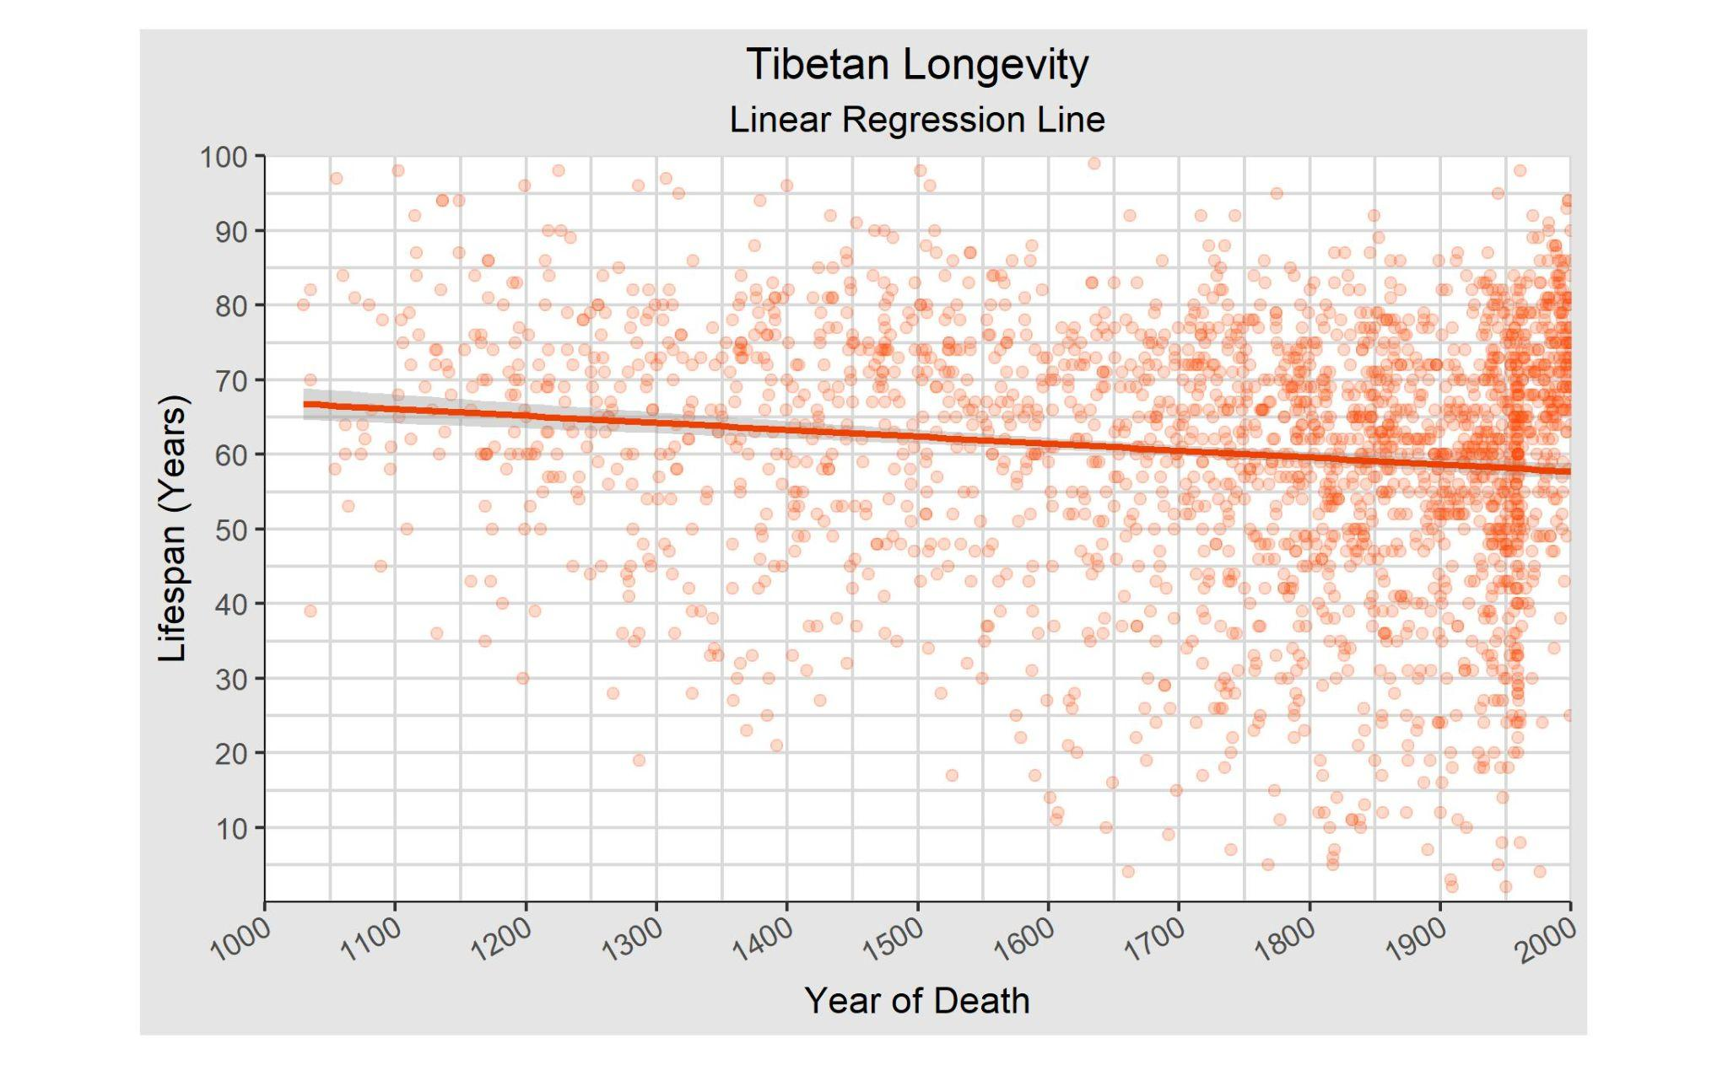

Slide 37
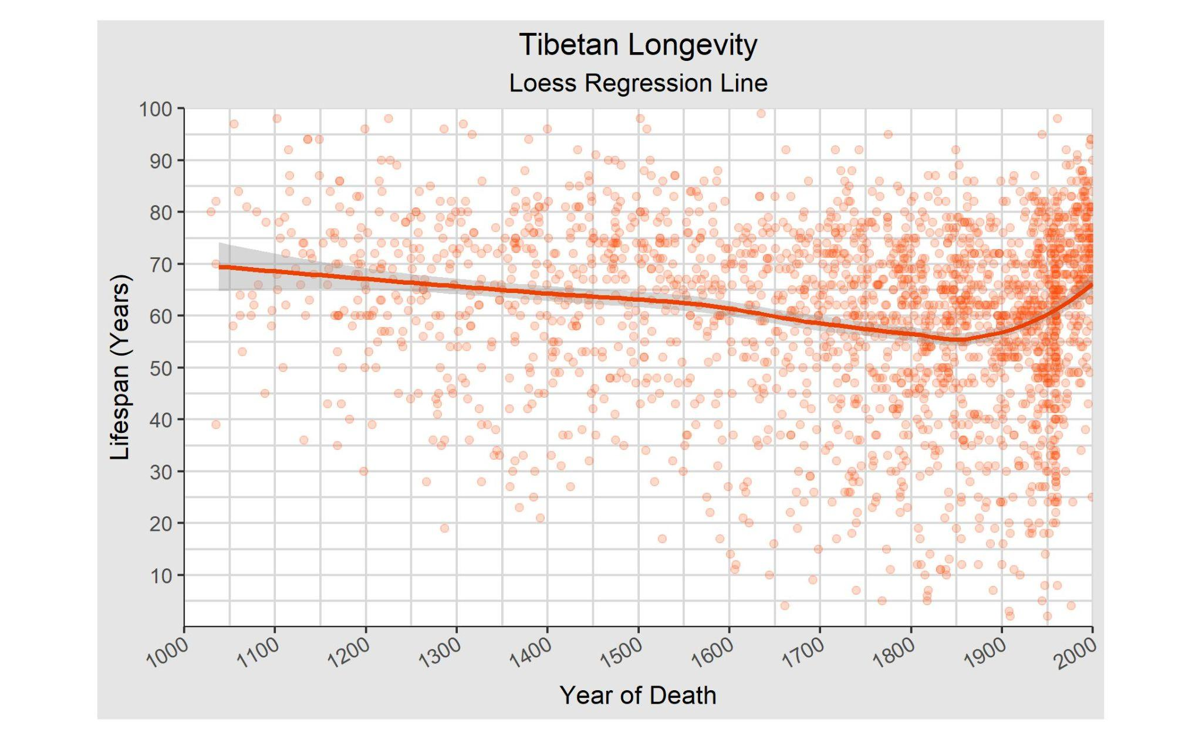

Slide 38
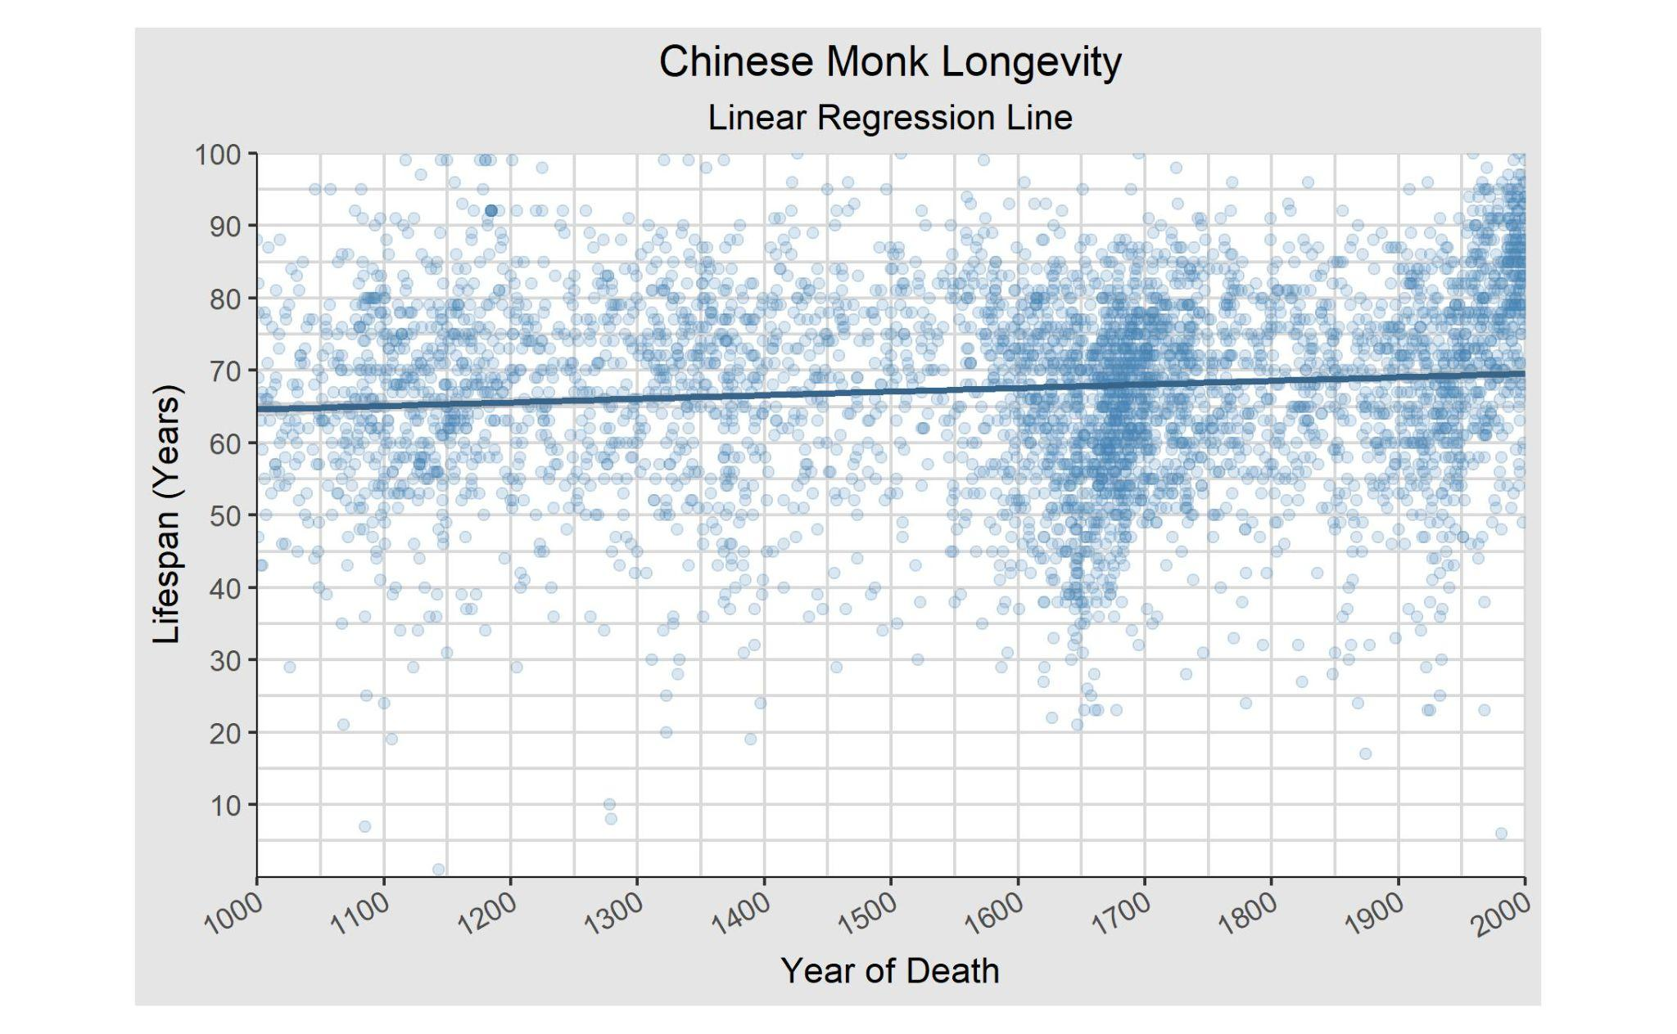

Slide 39
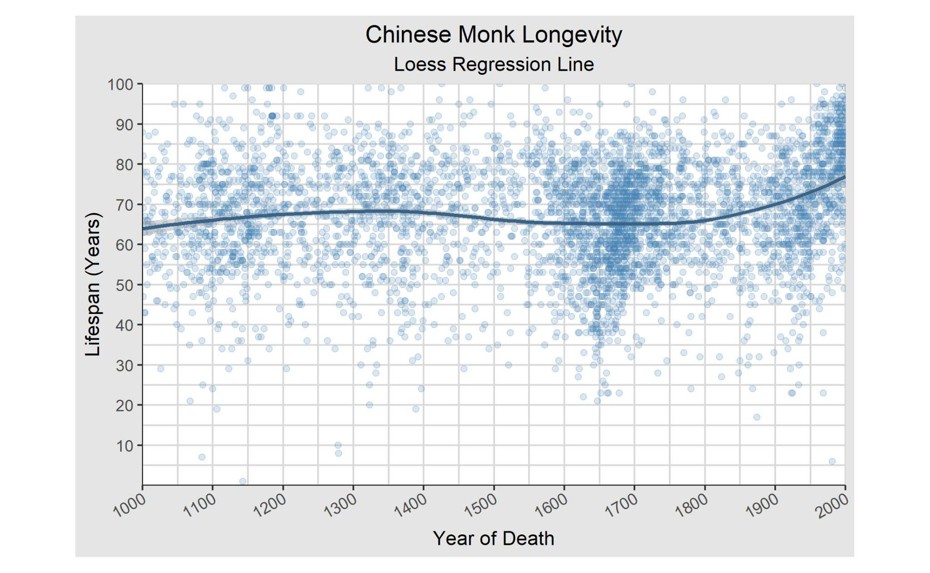

Slide 40
Wikidata
11/18/2022

Slide 41
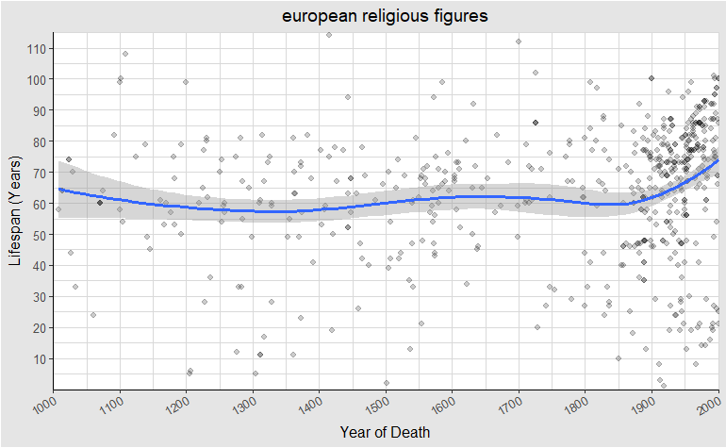

Slide 42
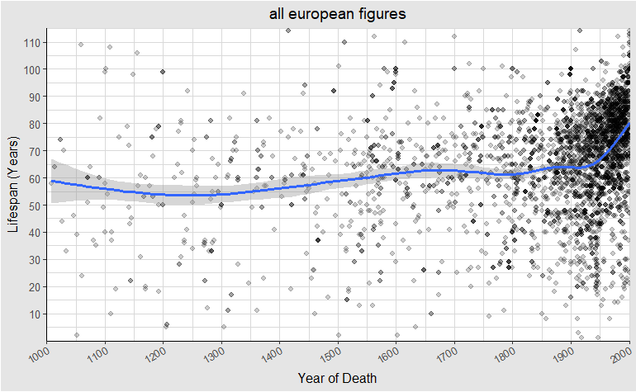

Slide 43
Under 50

Slide 44
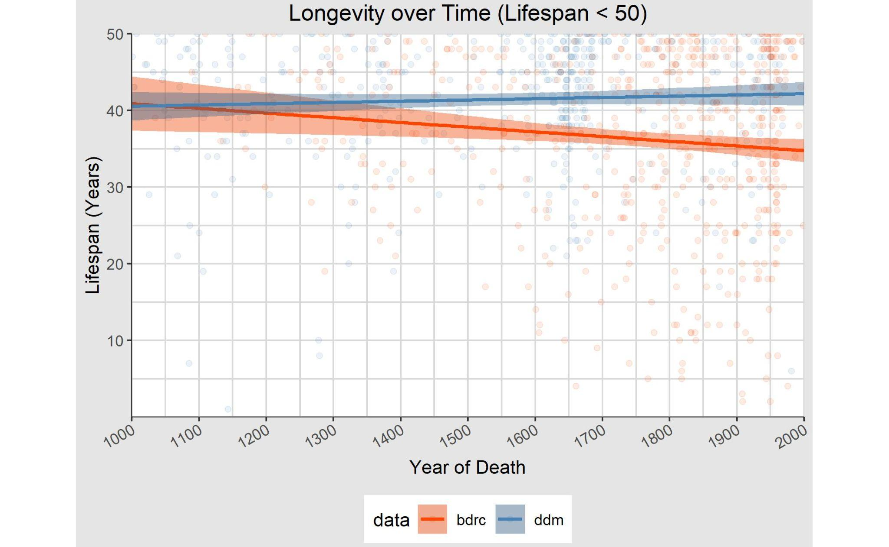

Slide 45
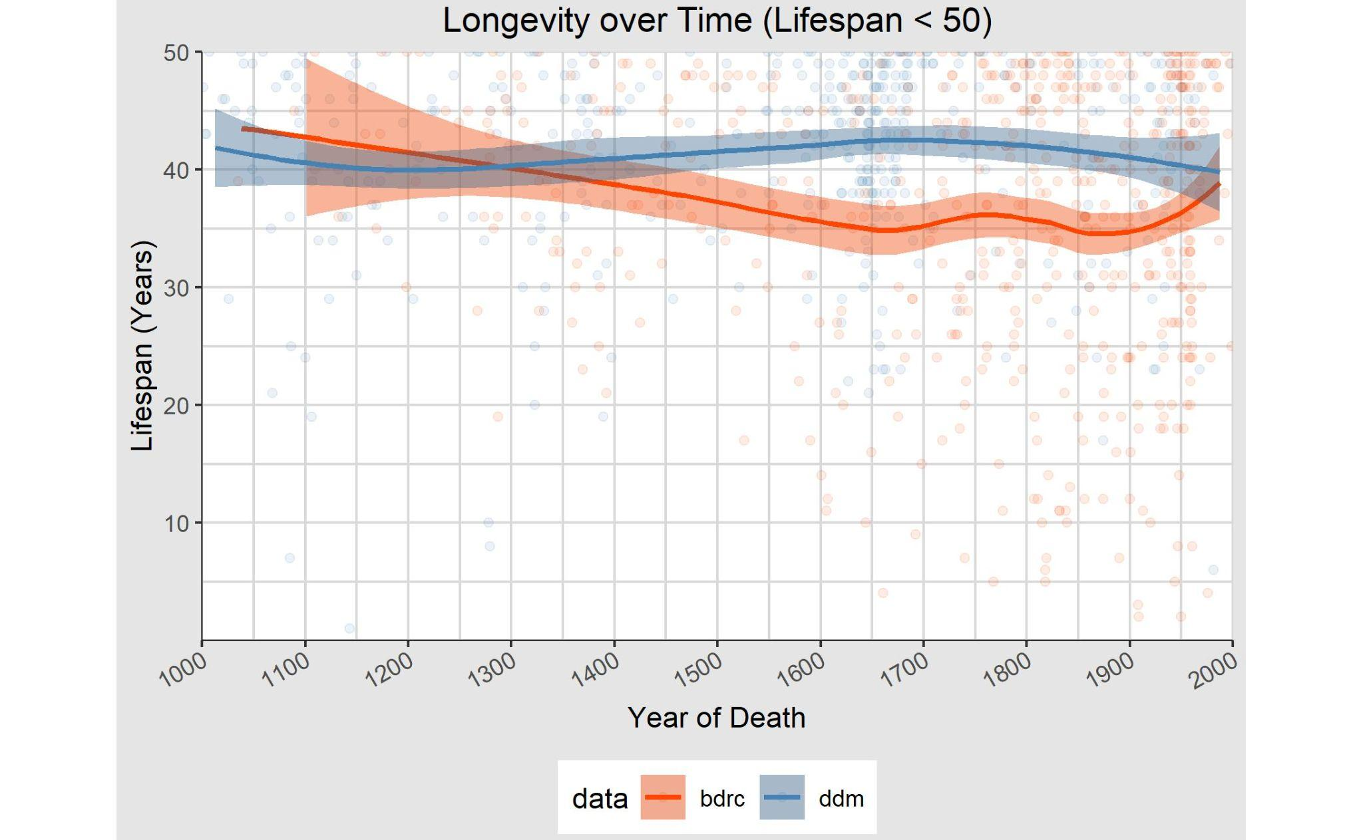

Slide 46
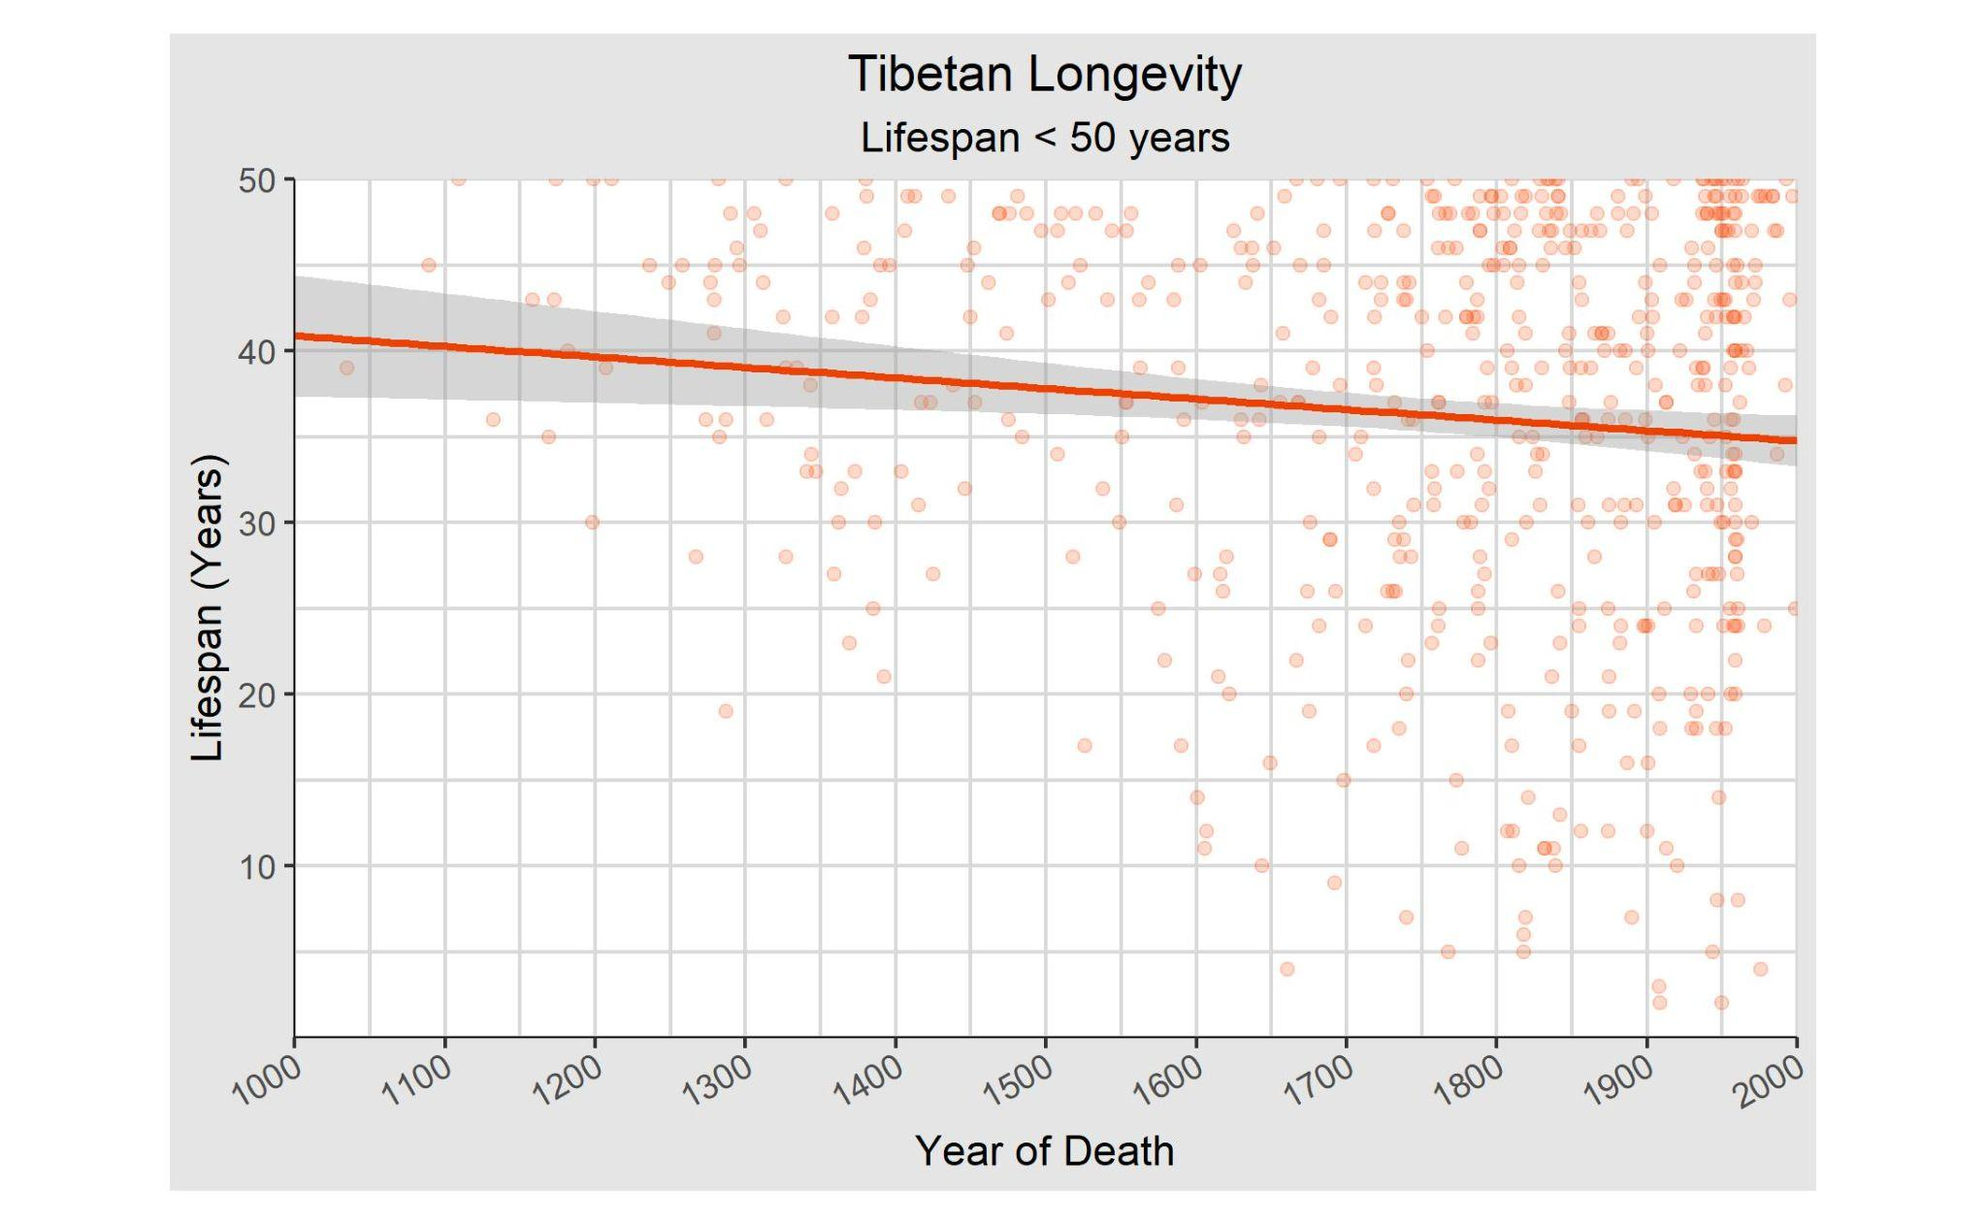

Slide 47
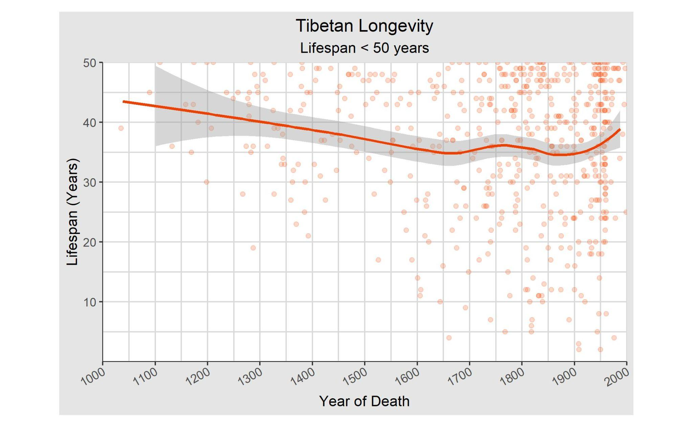

Slide 48
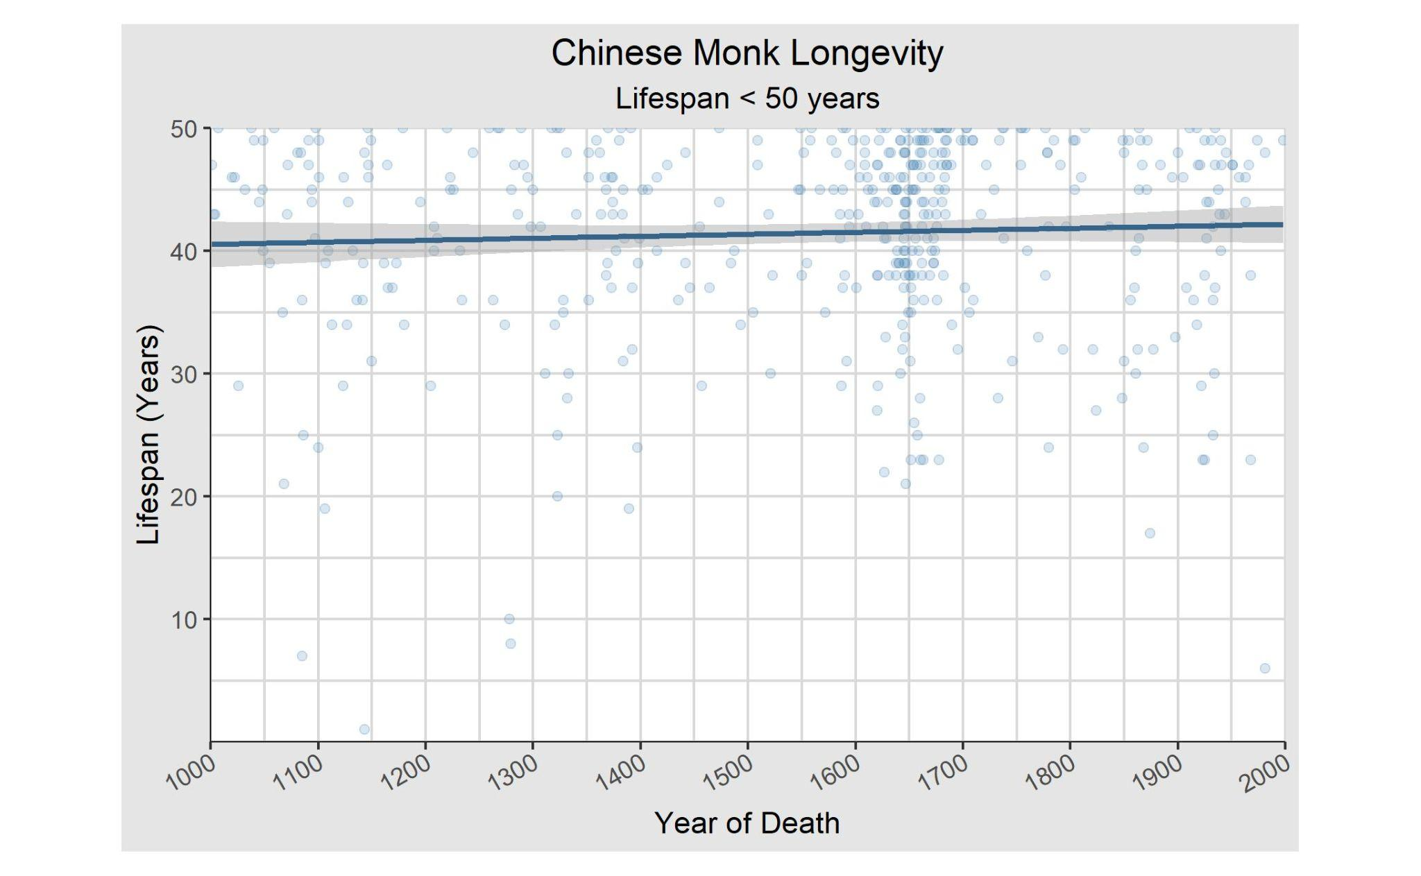

Slide 49
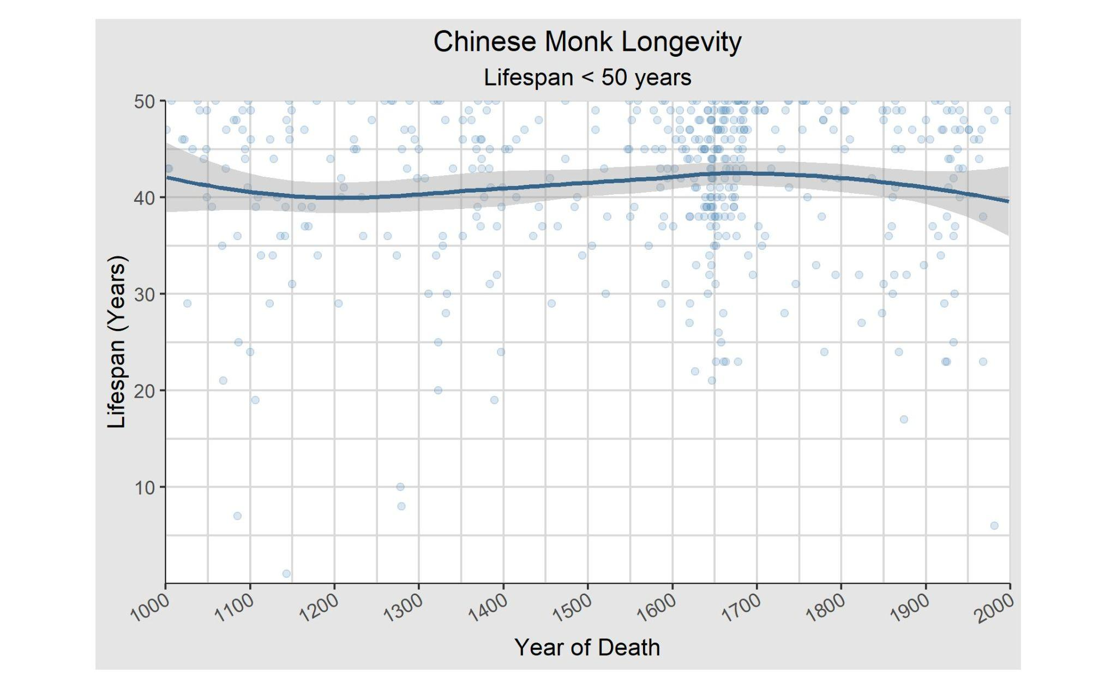

Slide 50
Over 50

Slide 51
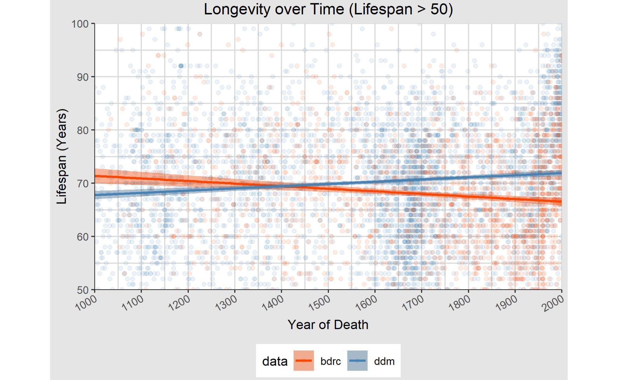

Slide 52
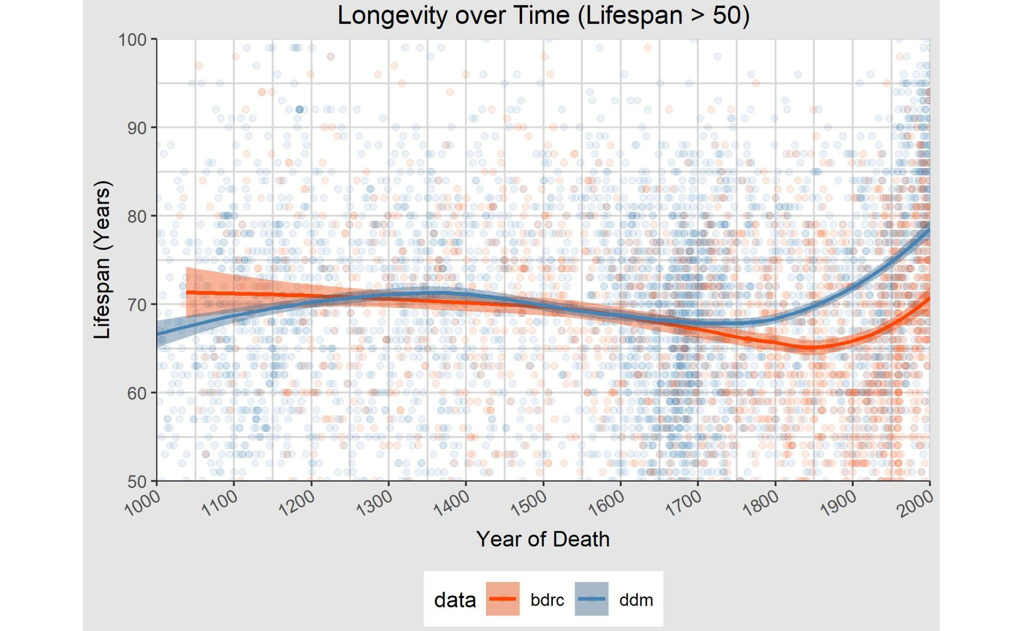

Slide 53
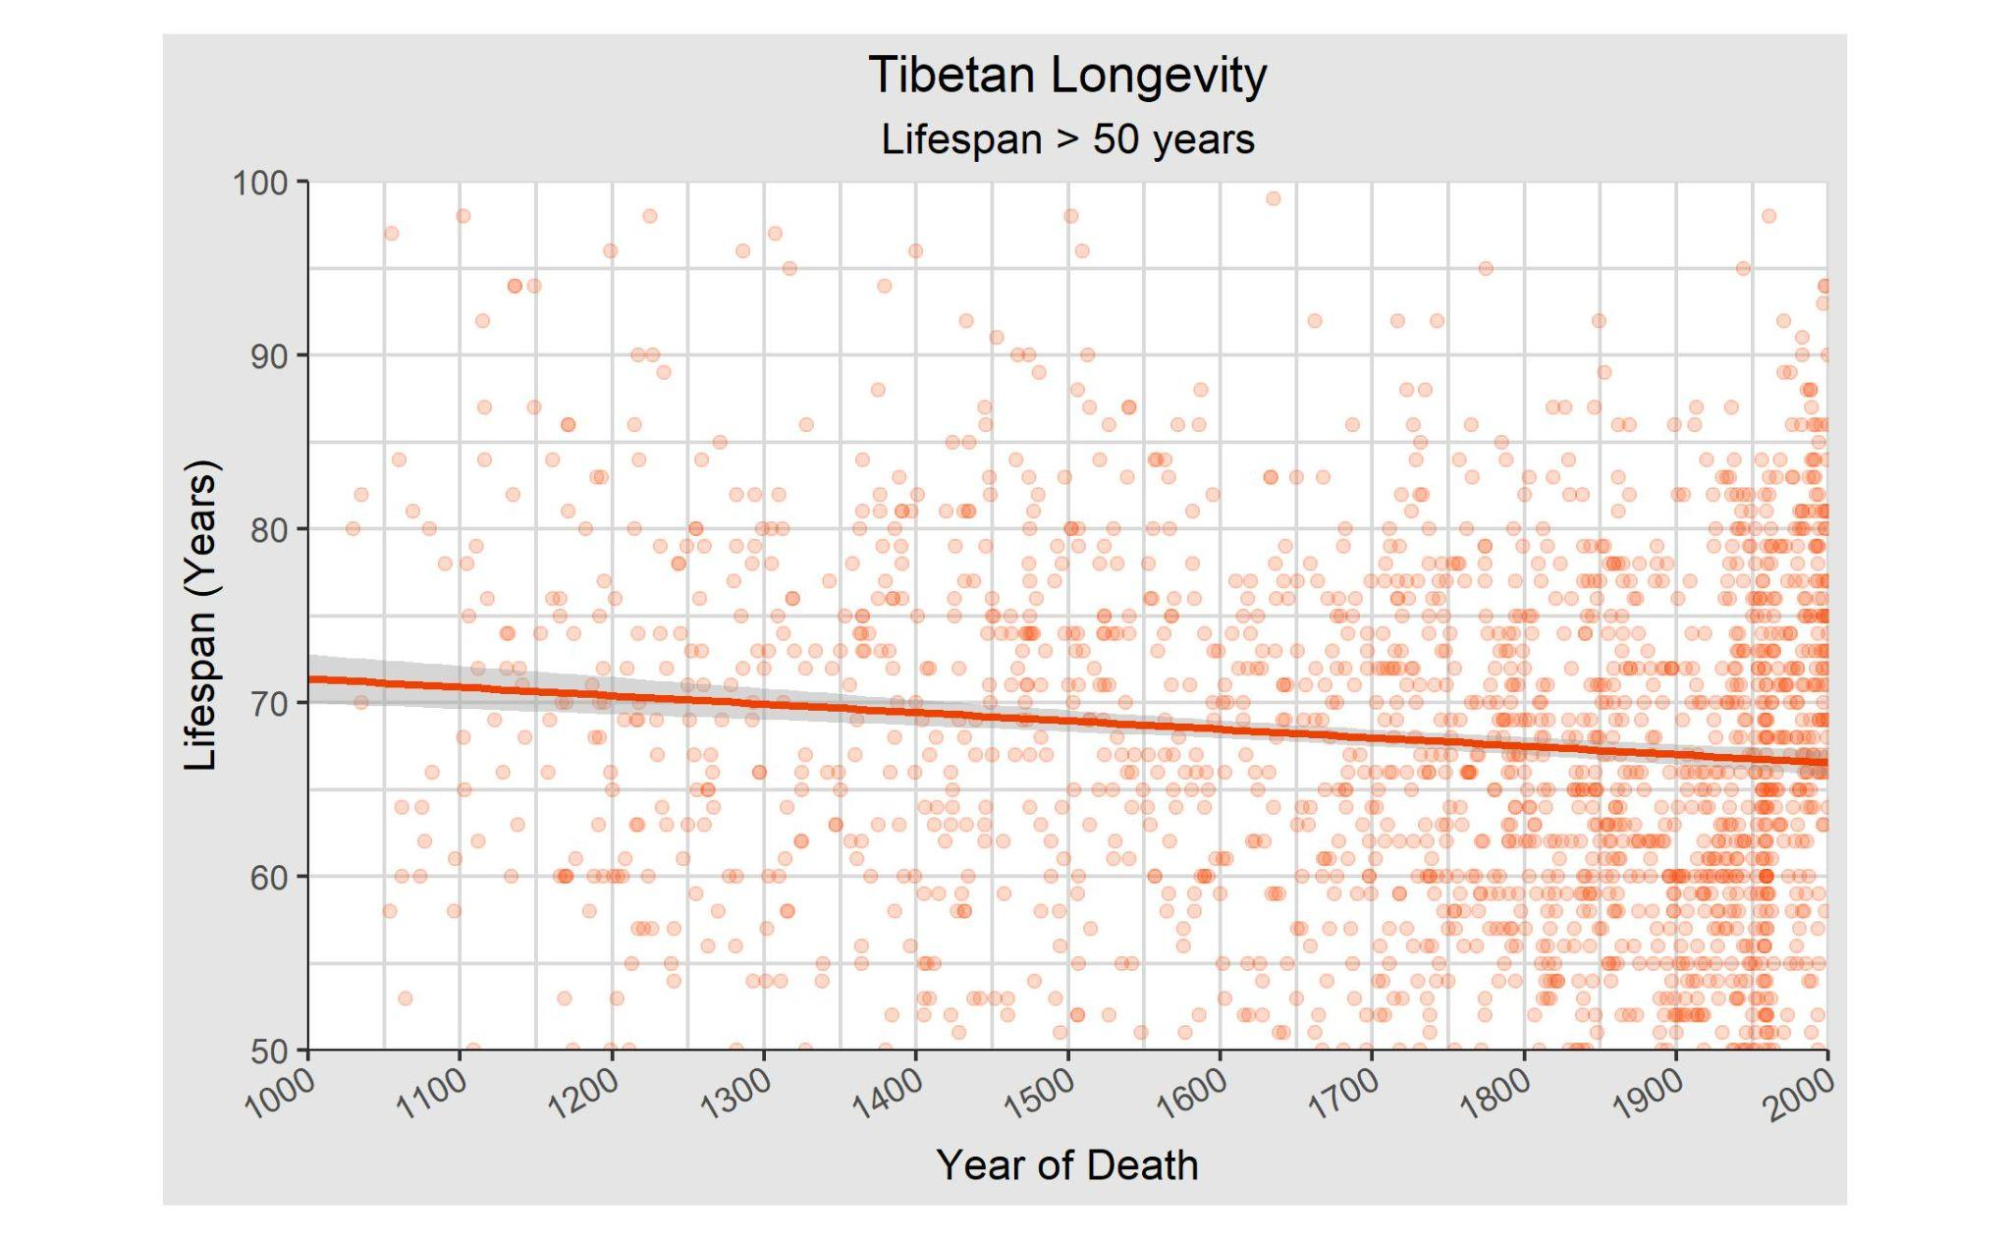

Slide 54
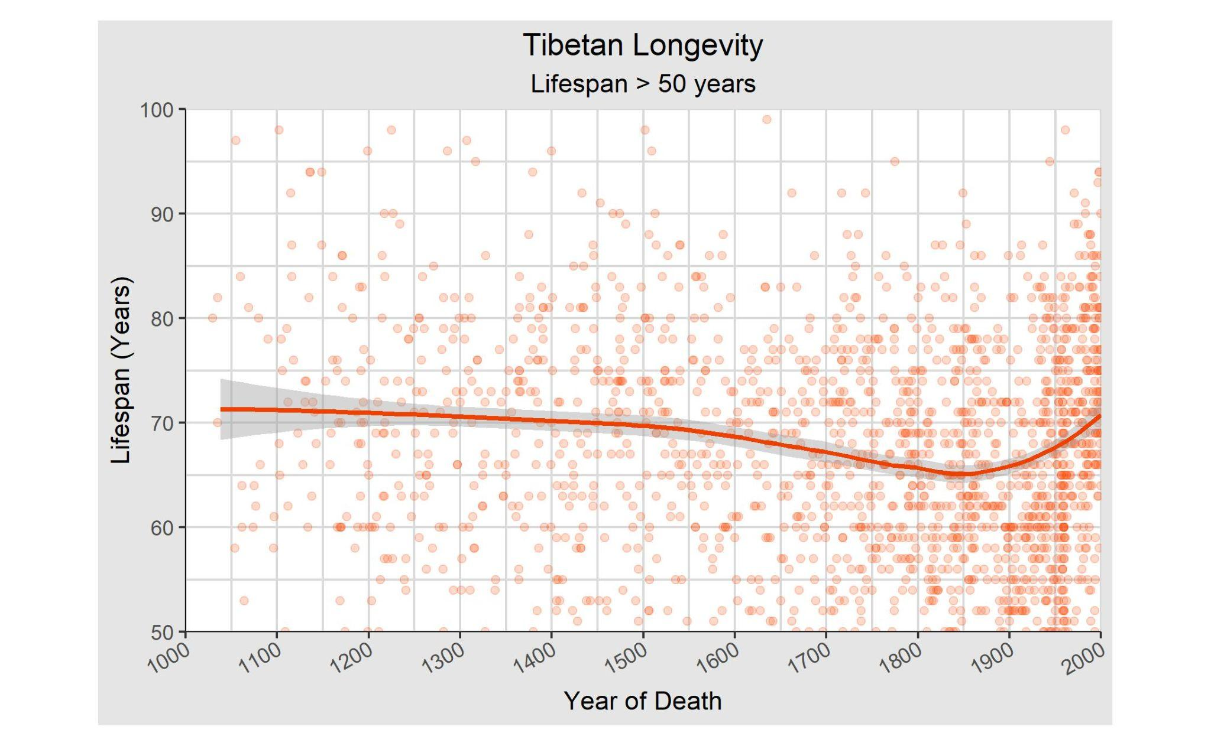

Slide 55
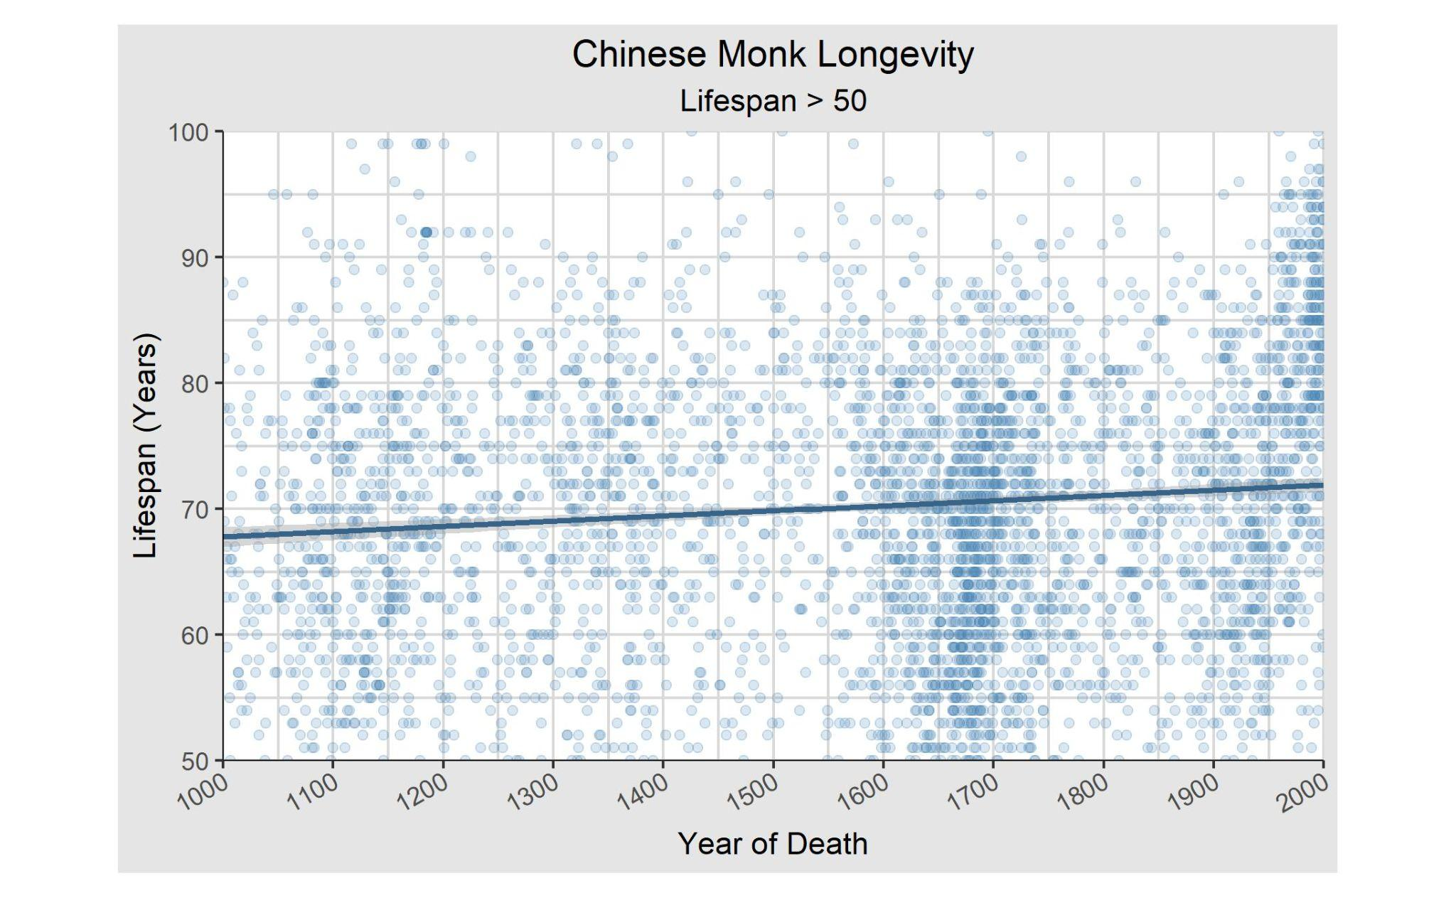

Slide 56
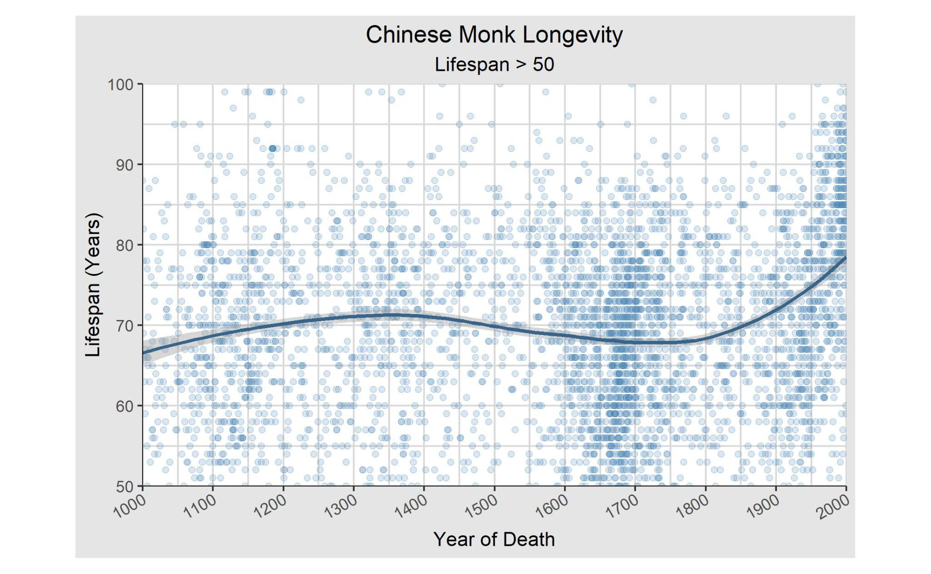

Slide 57
Under 30

Slide 58
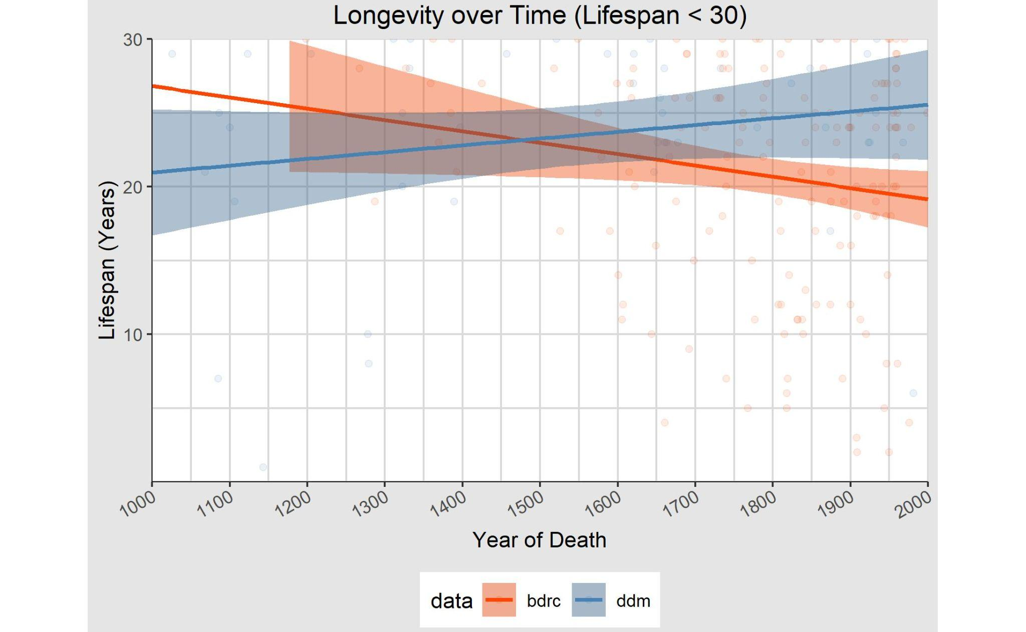

Slide 59
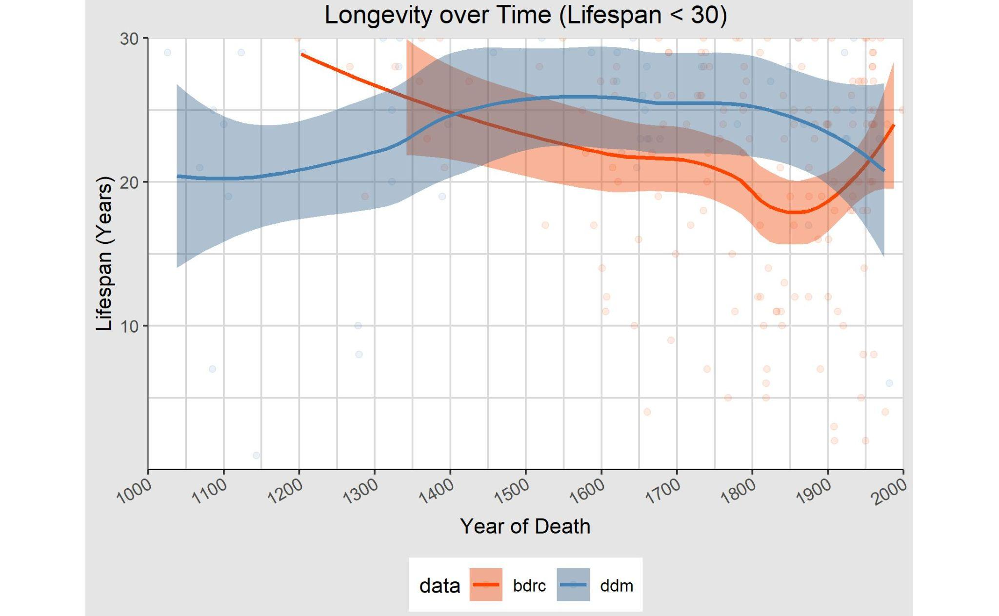

Slide 60
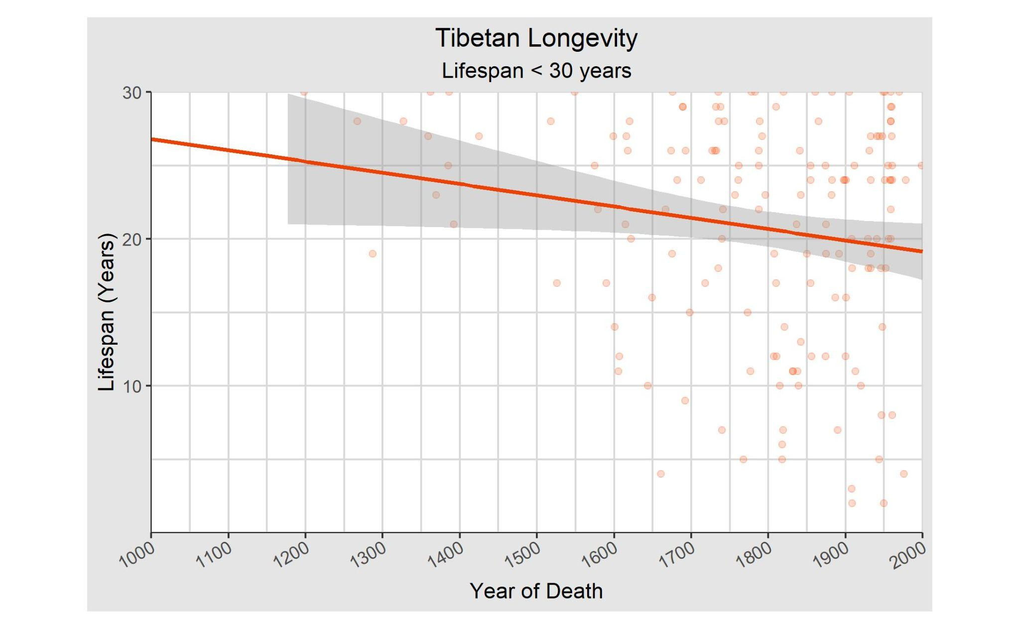
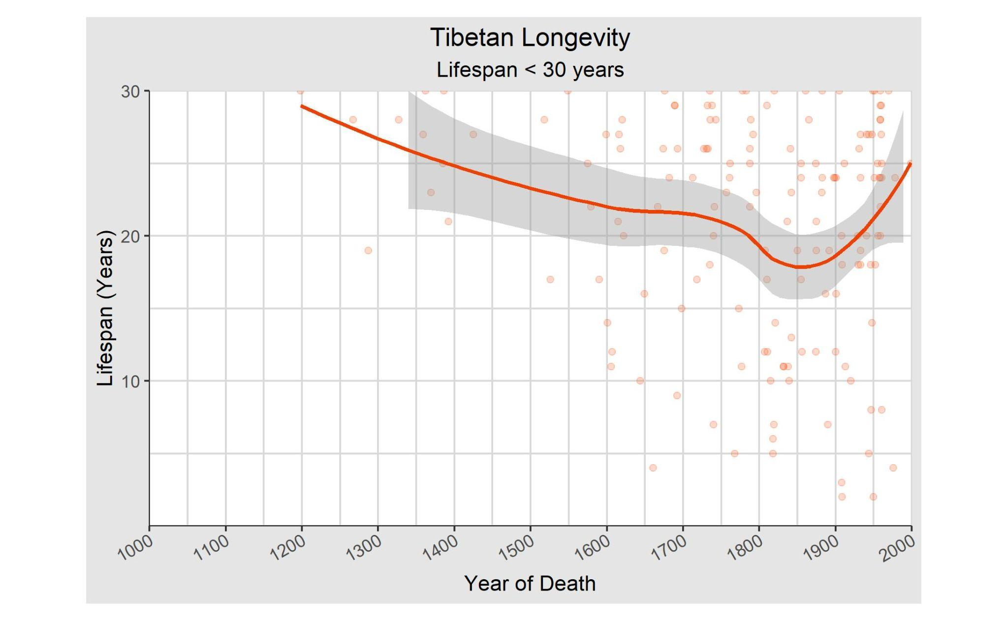

Slide 61


Slide 62
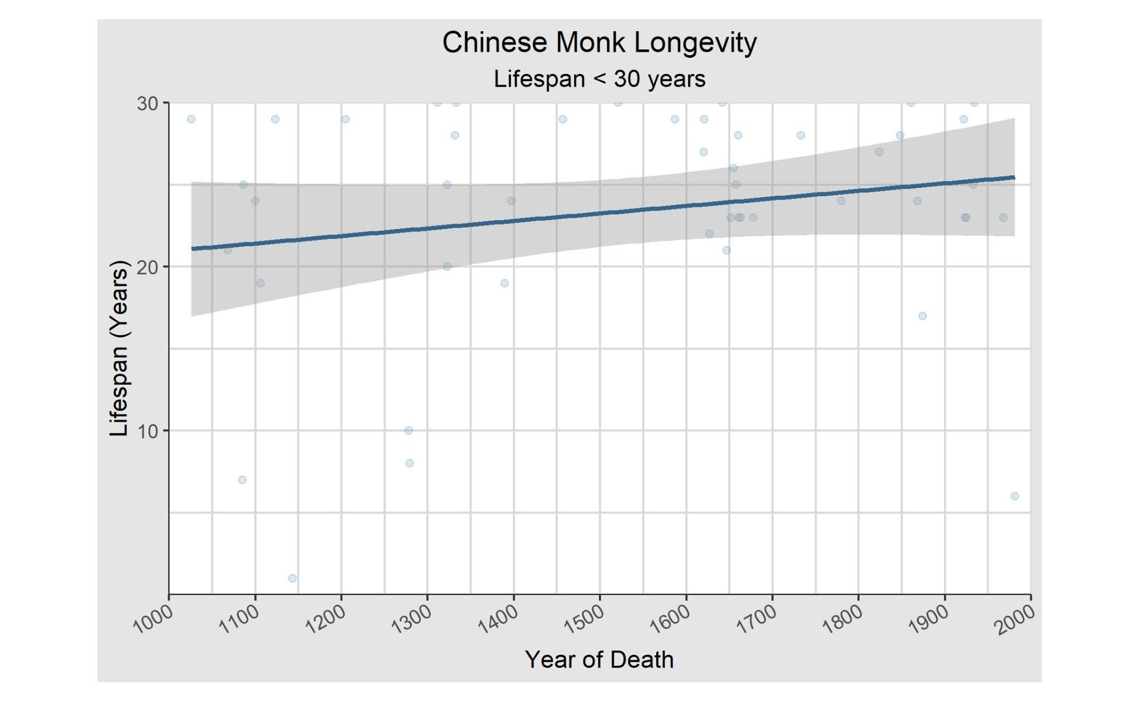

Slide 63
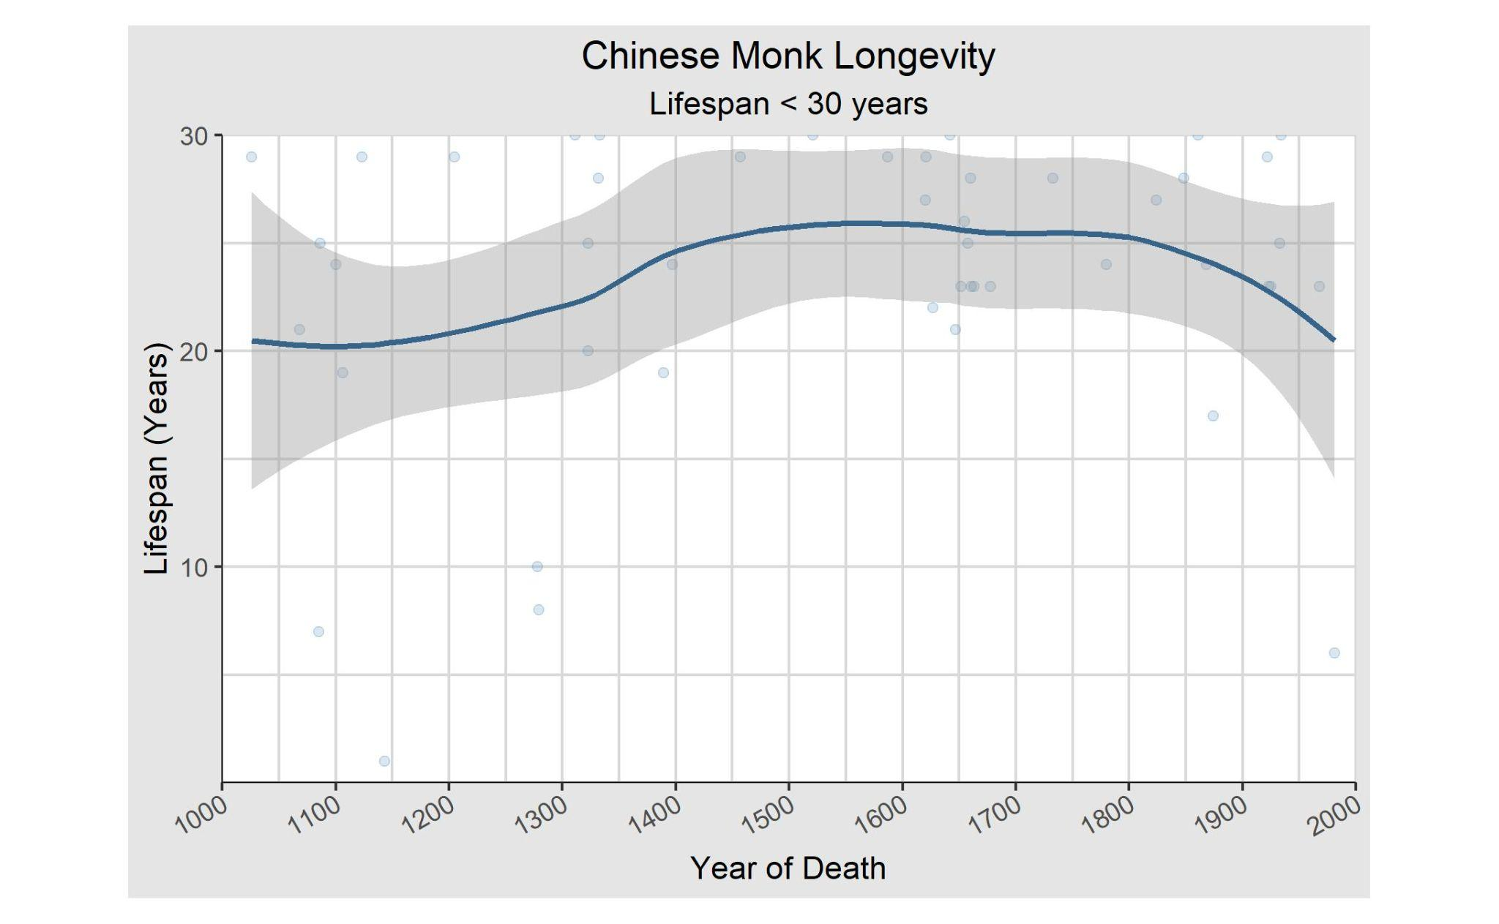

Slide 64
Over 30

Slide 65
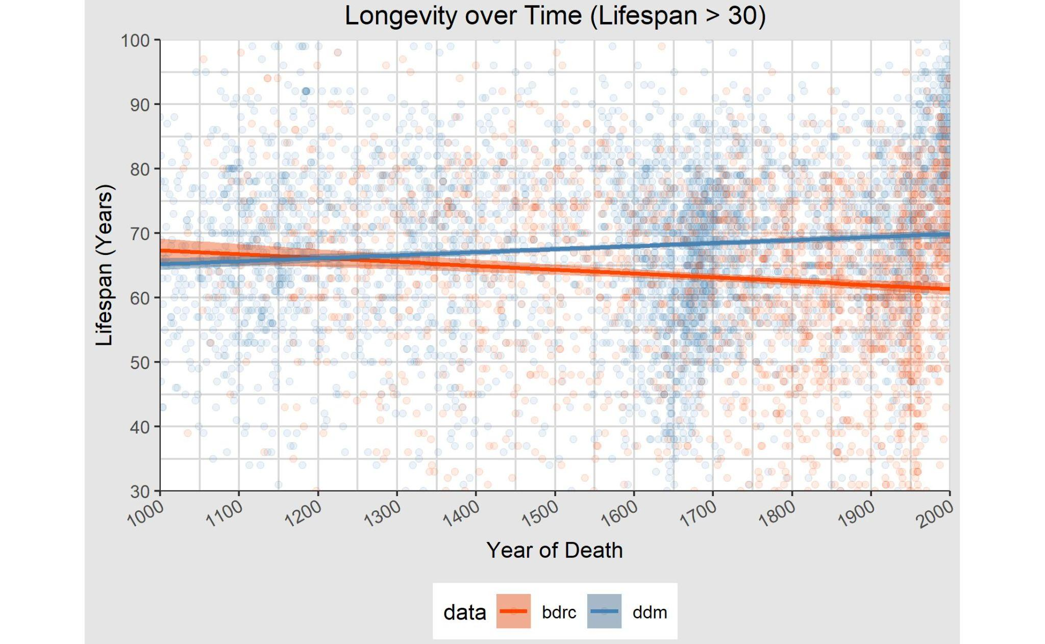

Slide 66
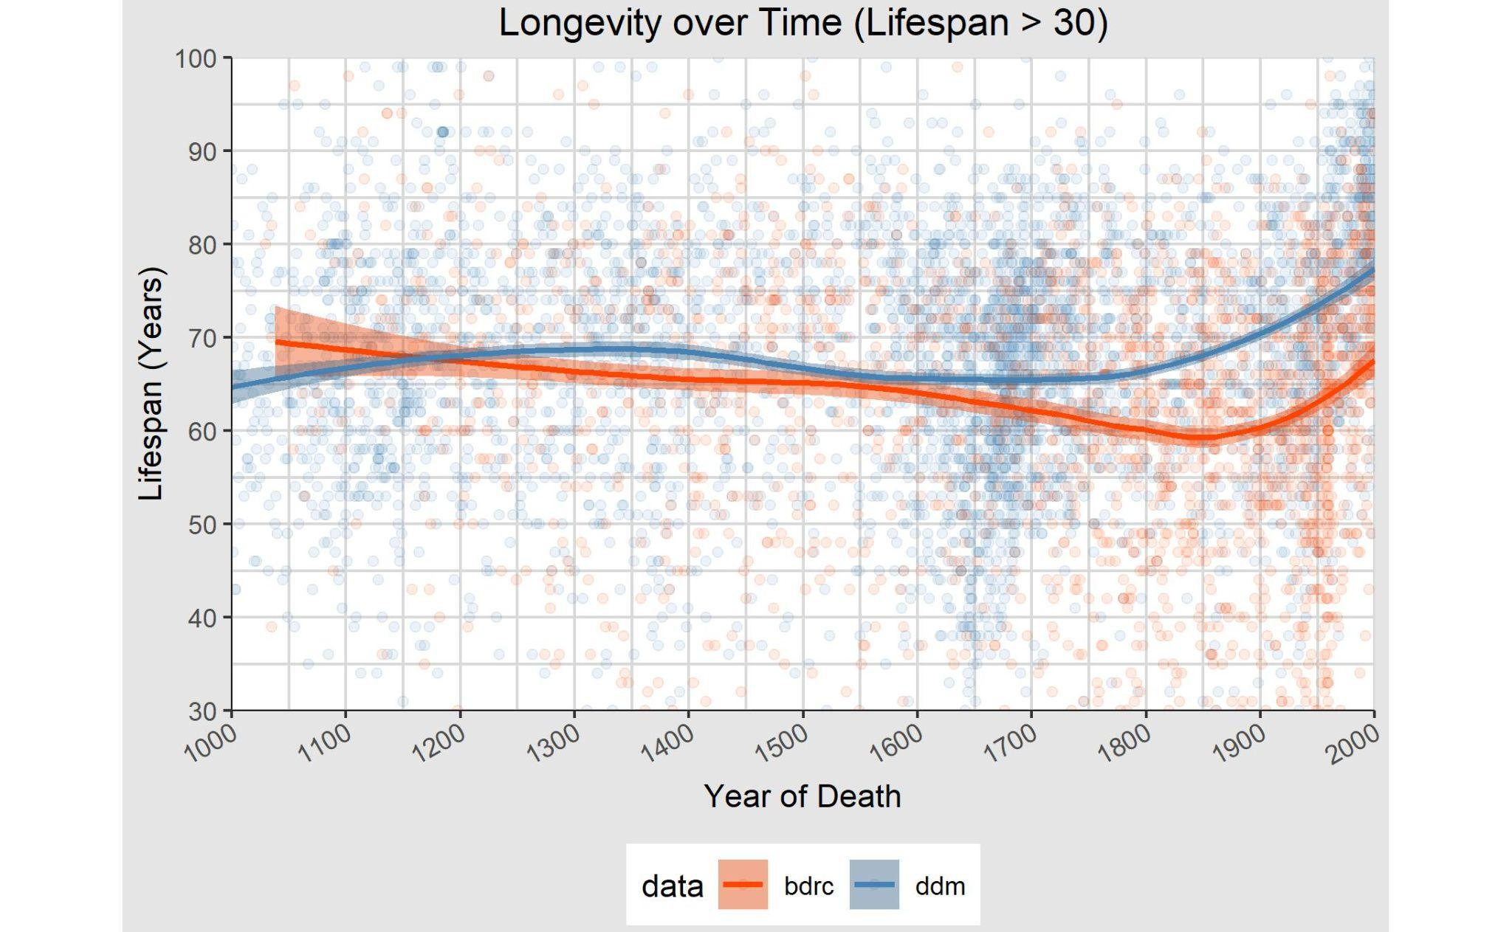

Slide 67
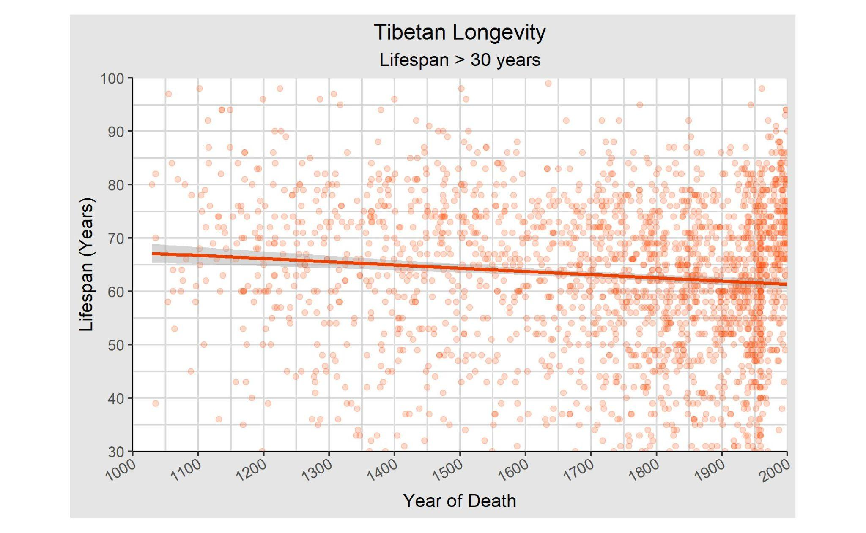

Slide 68
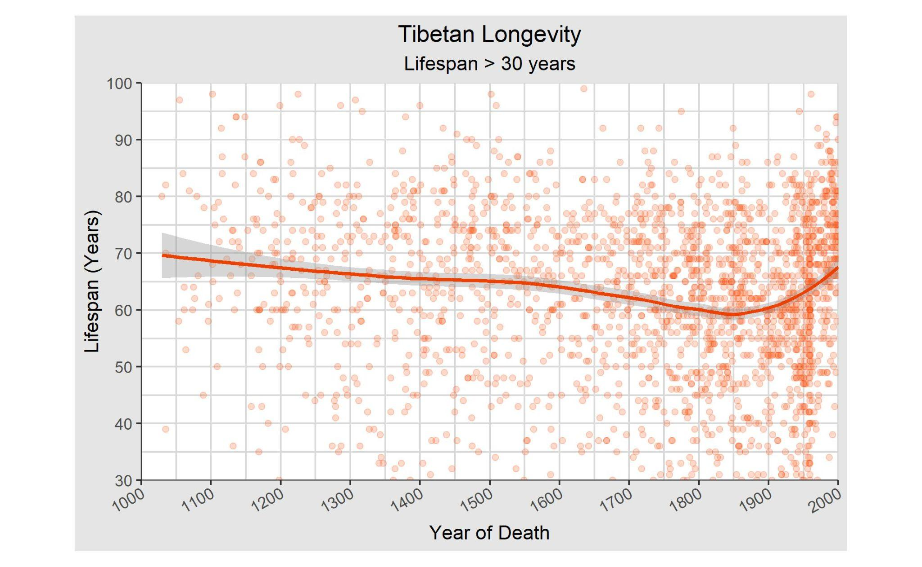

Slide 69
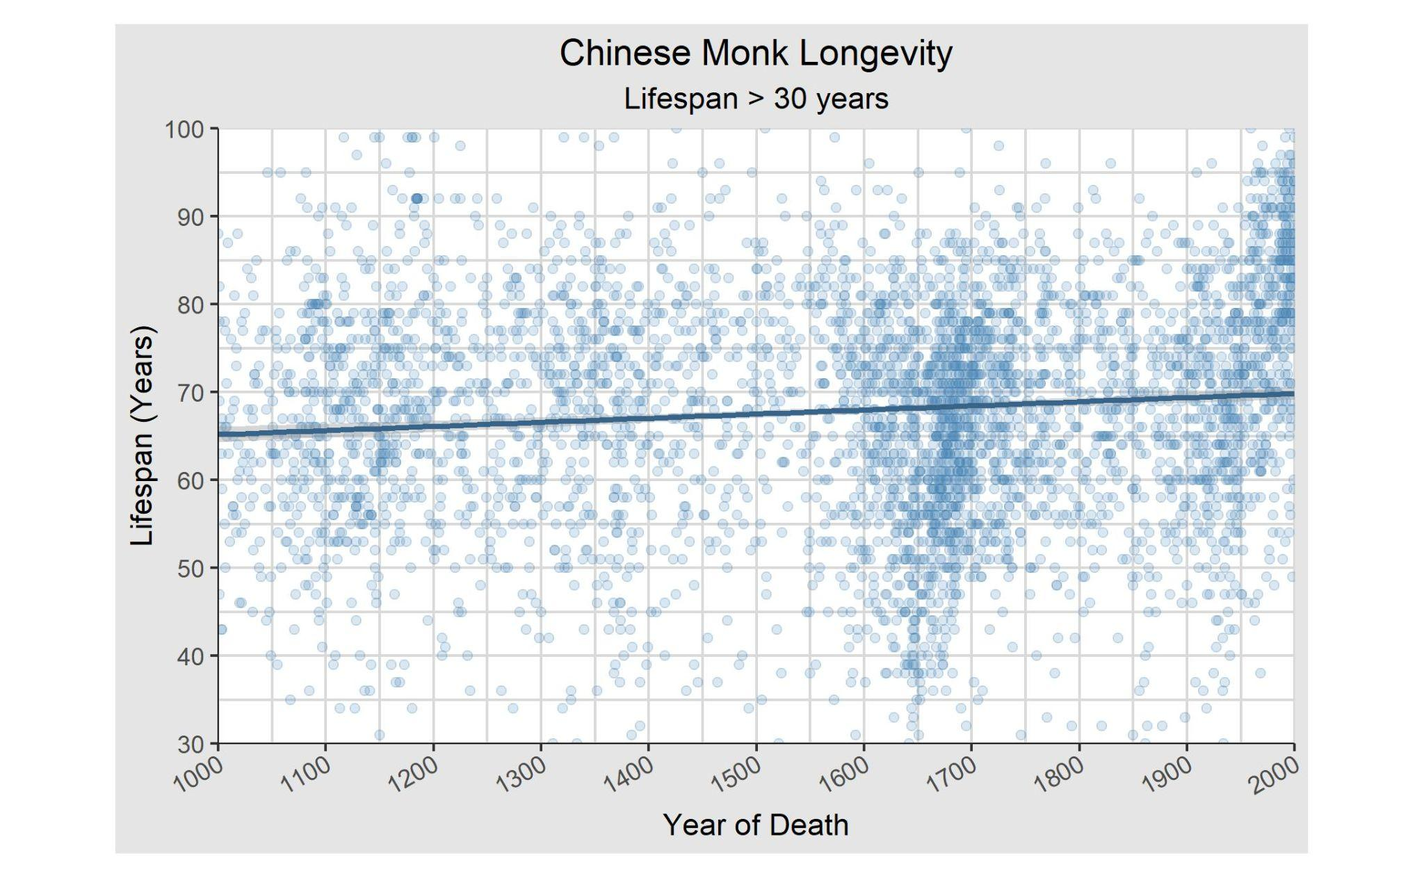

Slide 70
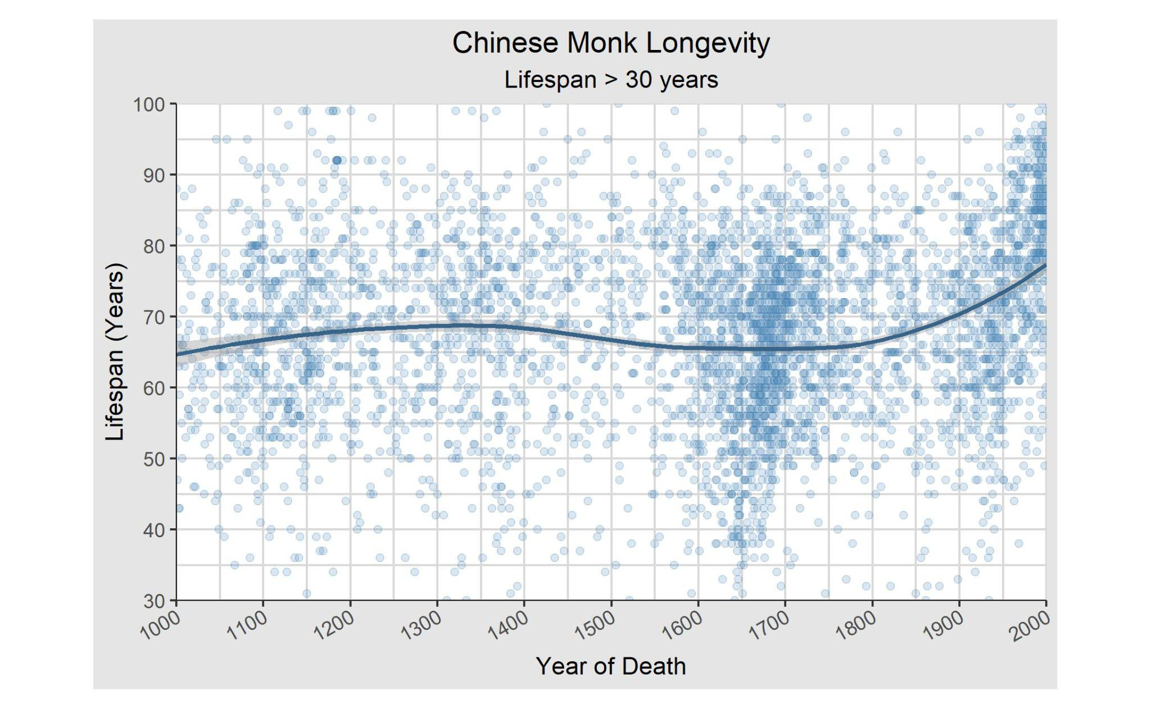

Slide 71
Other Cut-Offs

Slide 72


Slide 73


Slide 74


Slide 75
Longevity of Incarnation Lines

Slide 76
Exploring Incarnation Lines

Slide 77
Tulku Lines Data
We mimic each incarnation line into an individual lifespan.
Ex. A Tibetan individual would have a lifespan spanning a couple hundred years.
For Tibetan figures, the cut-off lifespan is 100. For Tulku lines, there are no bounds to the lifespan.
Lifespan is calculated by death_year - birth_year (As opposed to summing all Tulku lifespans)
GWT: How we treated lines which split into two lines

Slide 78
Just Tulku Lines

Slide 79

After every 150 years, the average lifespan increases by 100 years.
Hits 300 years around 1990 (halfway point between 1959 & 2021)

Slide 80


Slide 81
Just Tibetan

Slide 82


Slide 83


Slide 84


Slide 85


Slide 86
Tibetan vs. Chinese

Slide 87


Slide 88


Slide 89


Slide 90


Slide 91


Slide 92


Slide 93


Slide 94
Tulkus vs. Tibetan Figures

Slide 95


Slide 96


Slide 97


Slide 98


